Slide 1
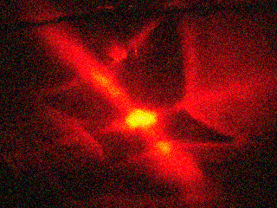
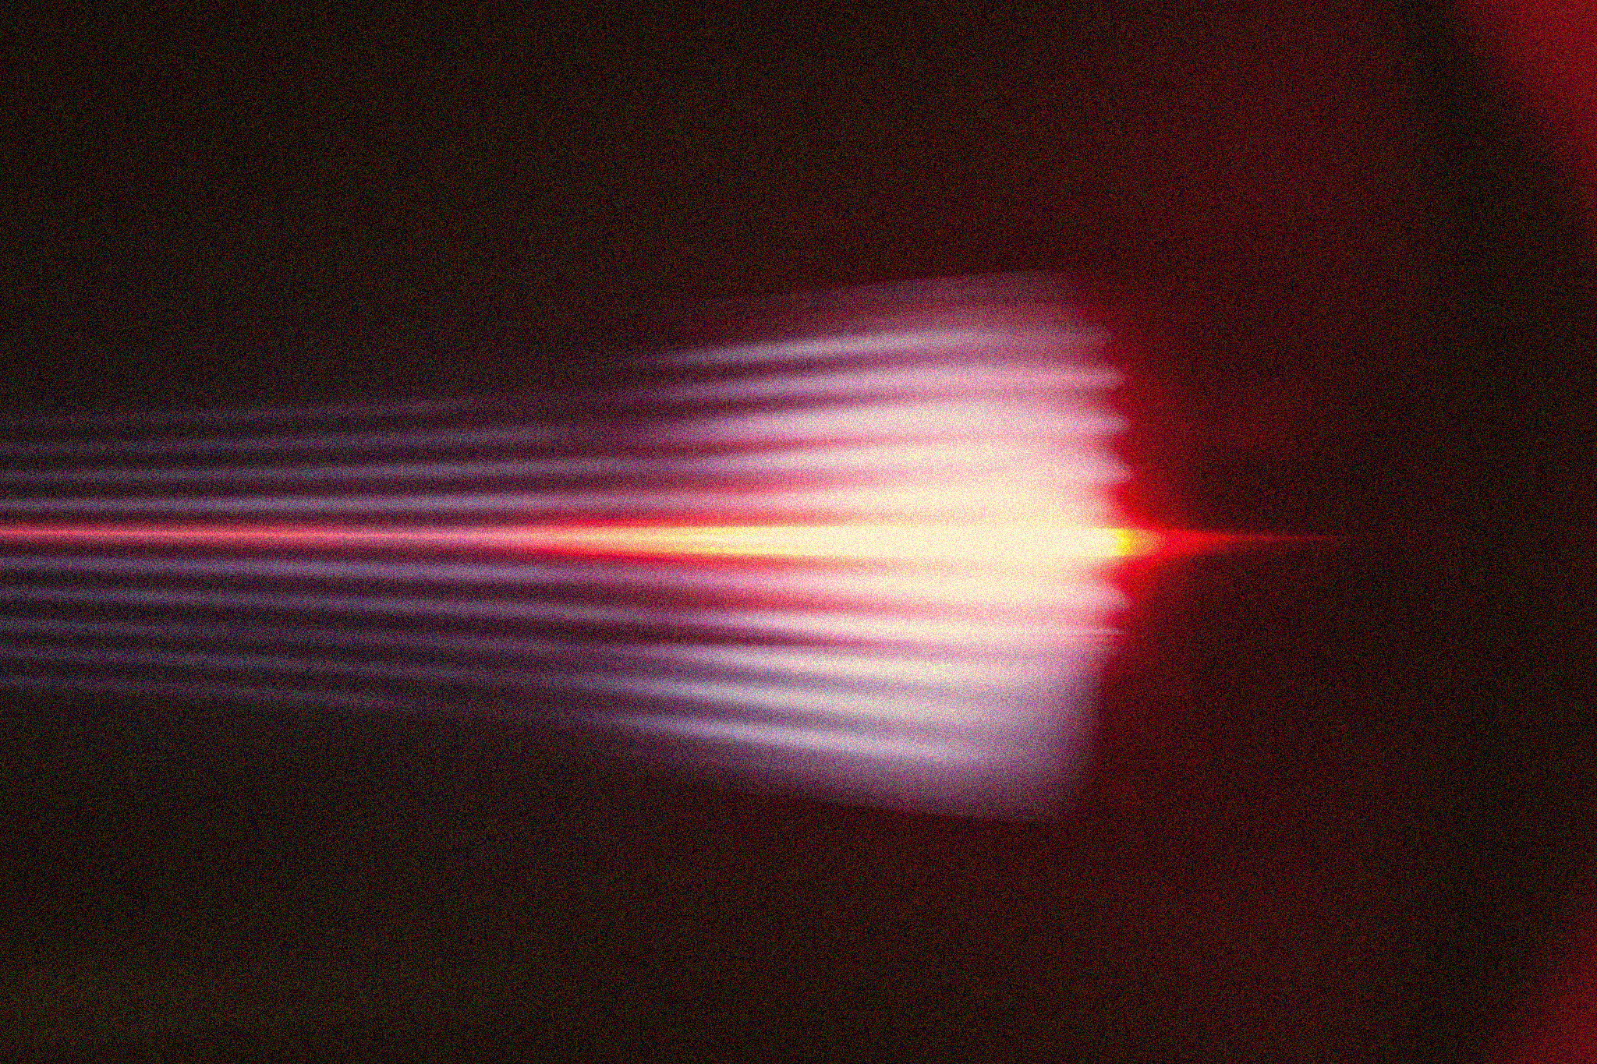
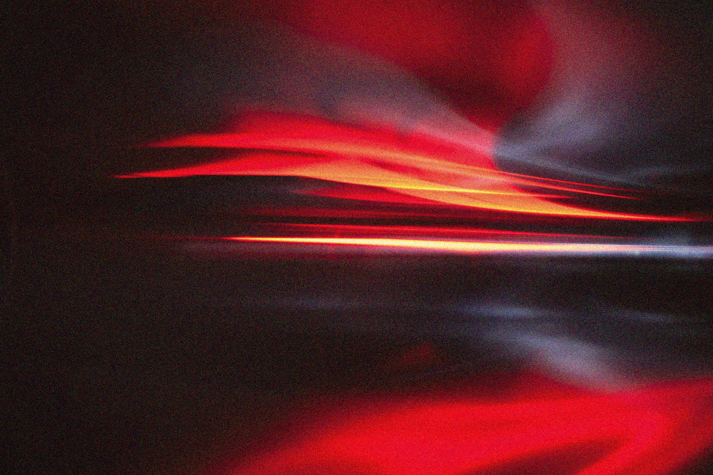
APP PHYSICS 157
COMPUTATIONAL ANALYSIS AND MODELLING
FOURIER TRANSFORM MODEL OF
IMAGE FORMATION
IMAGE AND VIDEO PROCESSING – MODULE 1
NINO PHILIP RAMONES | GITHUB
2020 – 05616
MARCH 24, 2023
This Photo by Unknown Author is licensed under CC BY-NC-ND

Slide 2
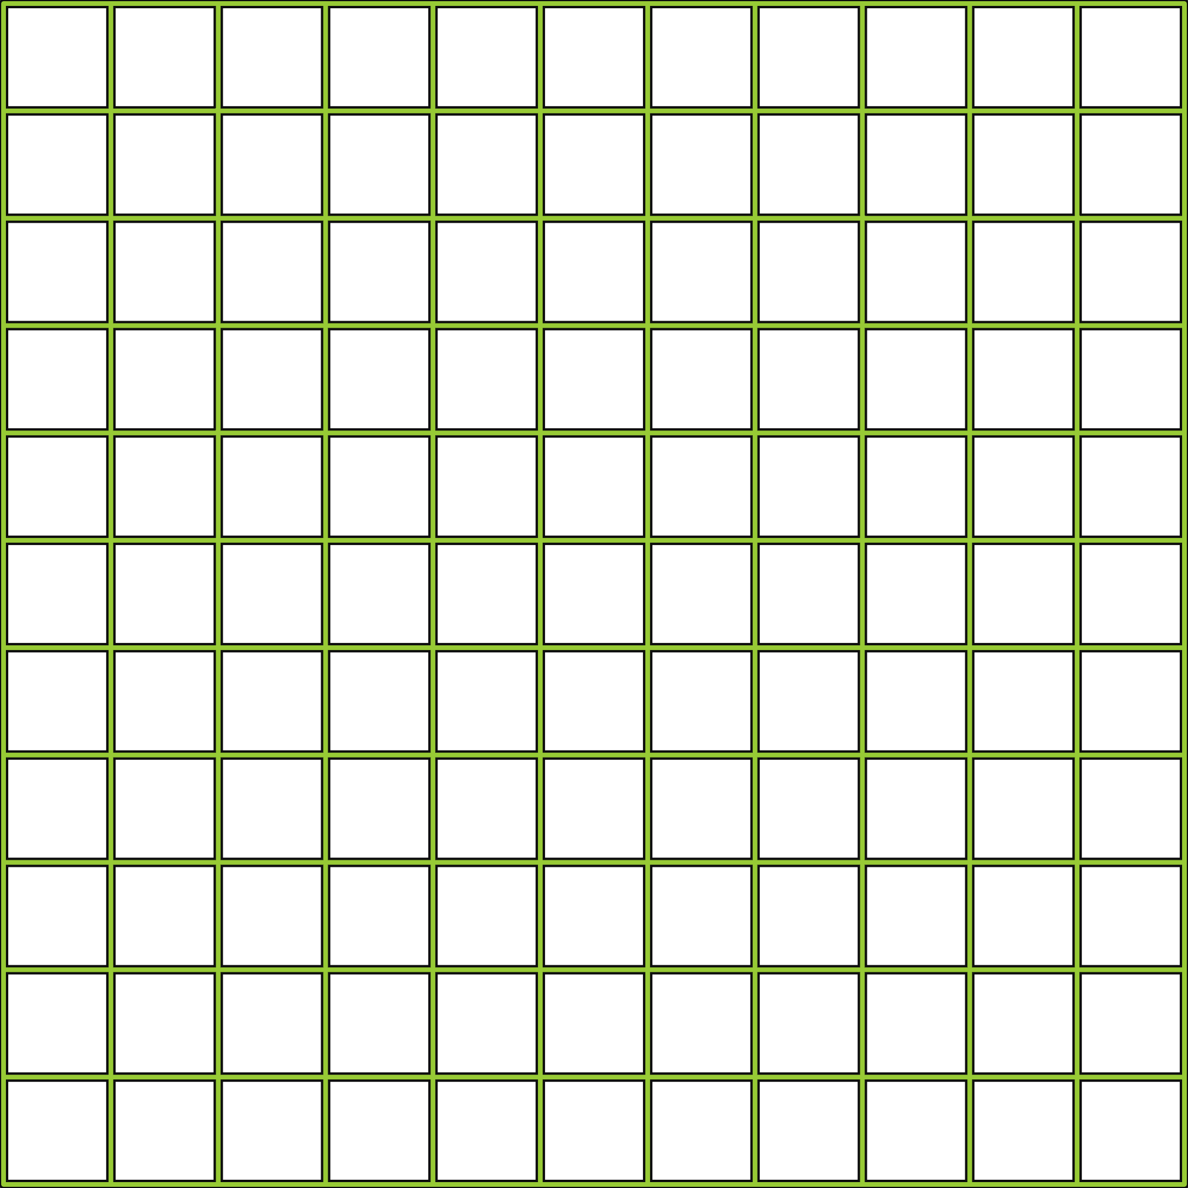
APP PHYSICS 157
FOURIER TRANSFORM MODEL OF IMAGE FORMATION
OBJECTIVES
Familiarize with the rudiments of Fourier transform and its various applications in simulating diffraction patterns and various imaging systems
Observe how Fourier transform comes into play in image convolution and correlation
KEY TAKEAWAYS
Setting your image resolution to any powers of two will greatly speed up the calculation process when subjected to FFT algorithms
Several imaging systems can be simulated using FFT by image convolution
Different aperture geometry yields a unique diffraction pattern
Some of the real-life applications of FFT are template matching and pattern recognition --- through the image correlation algorithm
SOME PITFALLS
The two images of interest that must be convolved or correlation must be of the same size as it processes both images by checking and comparing it pixel by pixel
Different image resolutions can somehow produce a different output that is far from the expected one; choose the right one through trial and error!

Slide 3
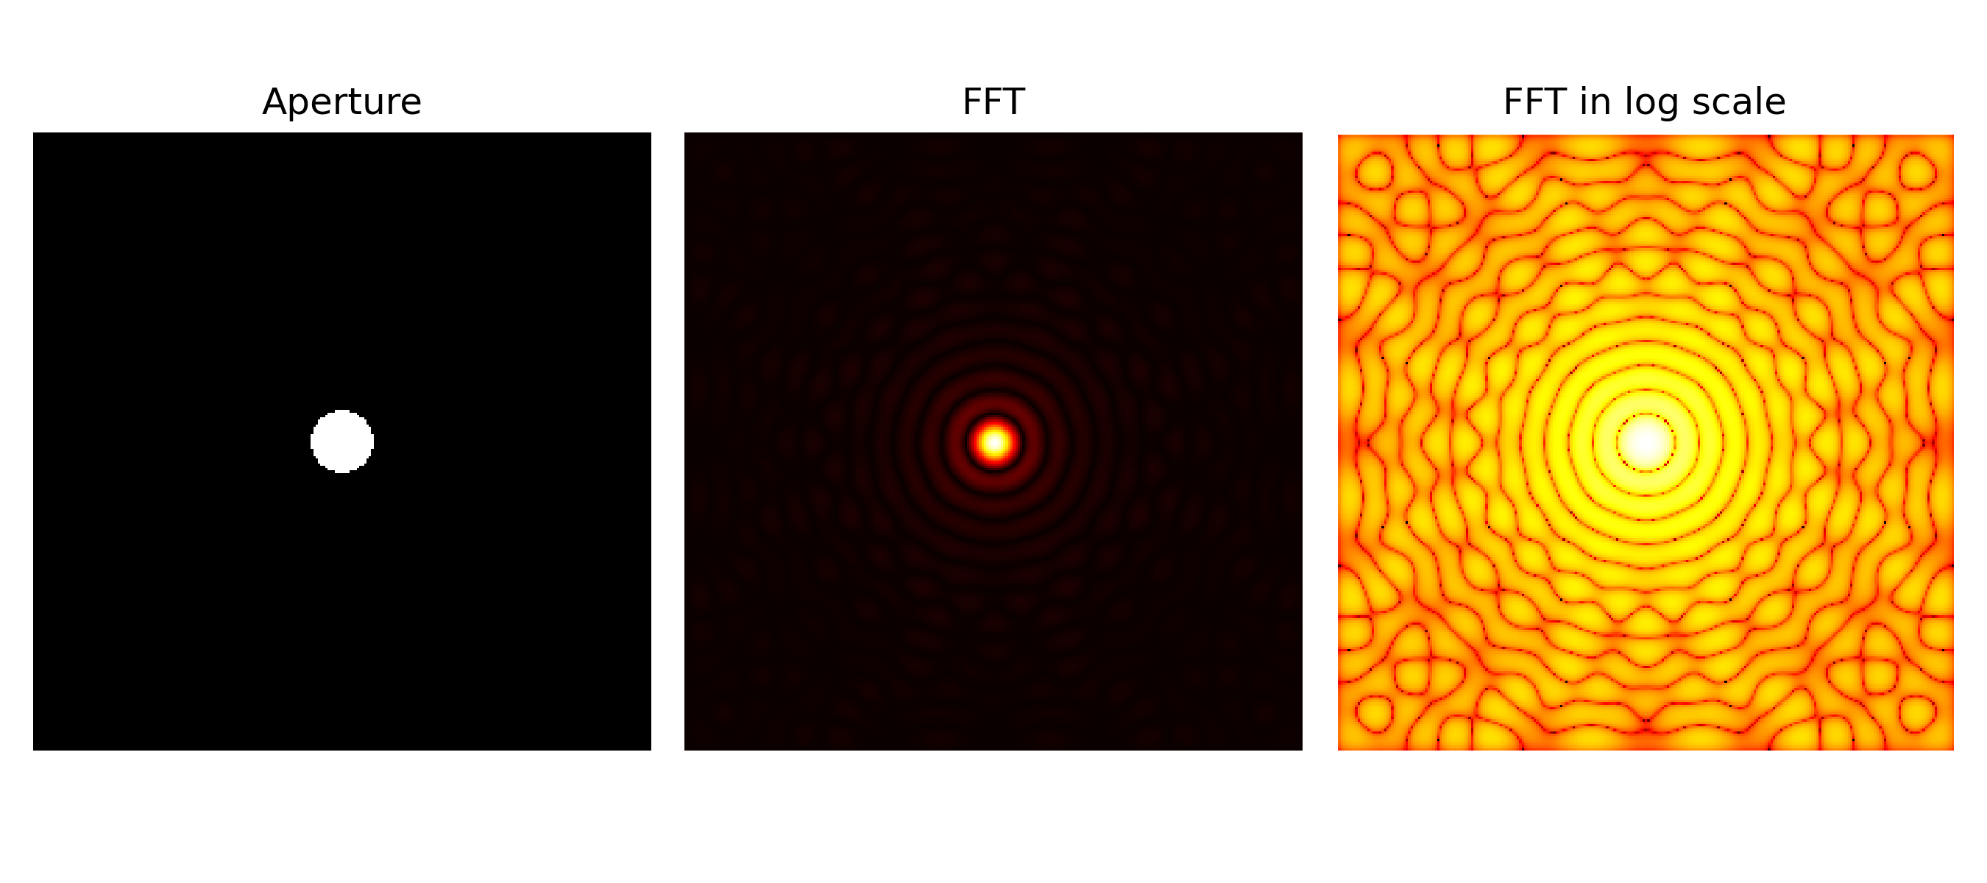
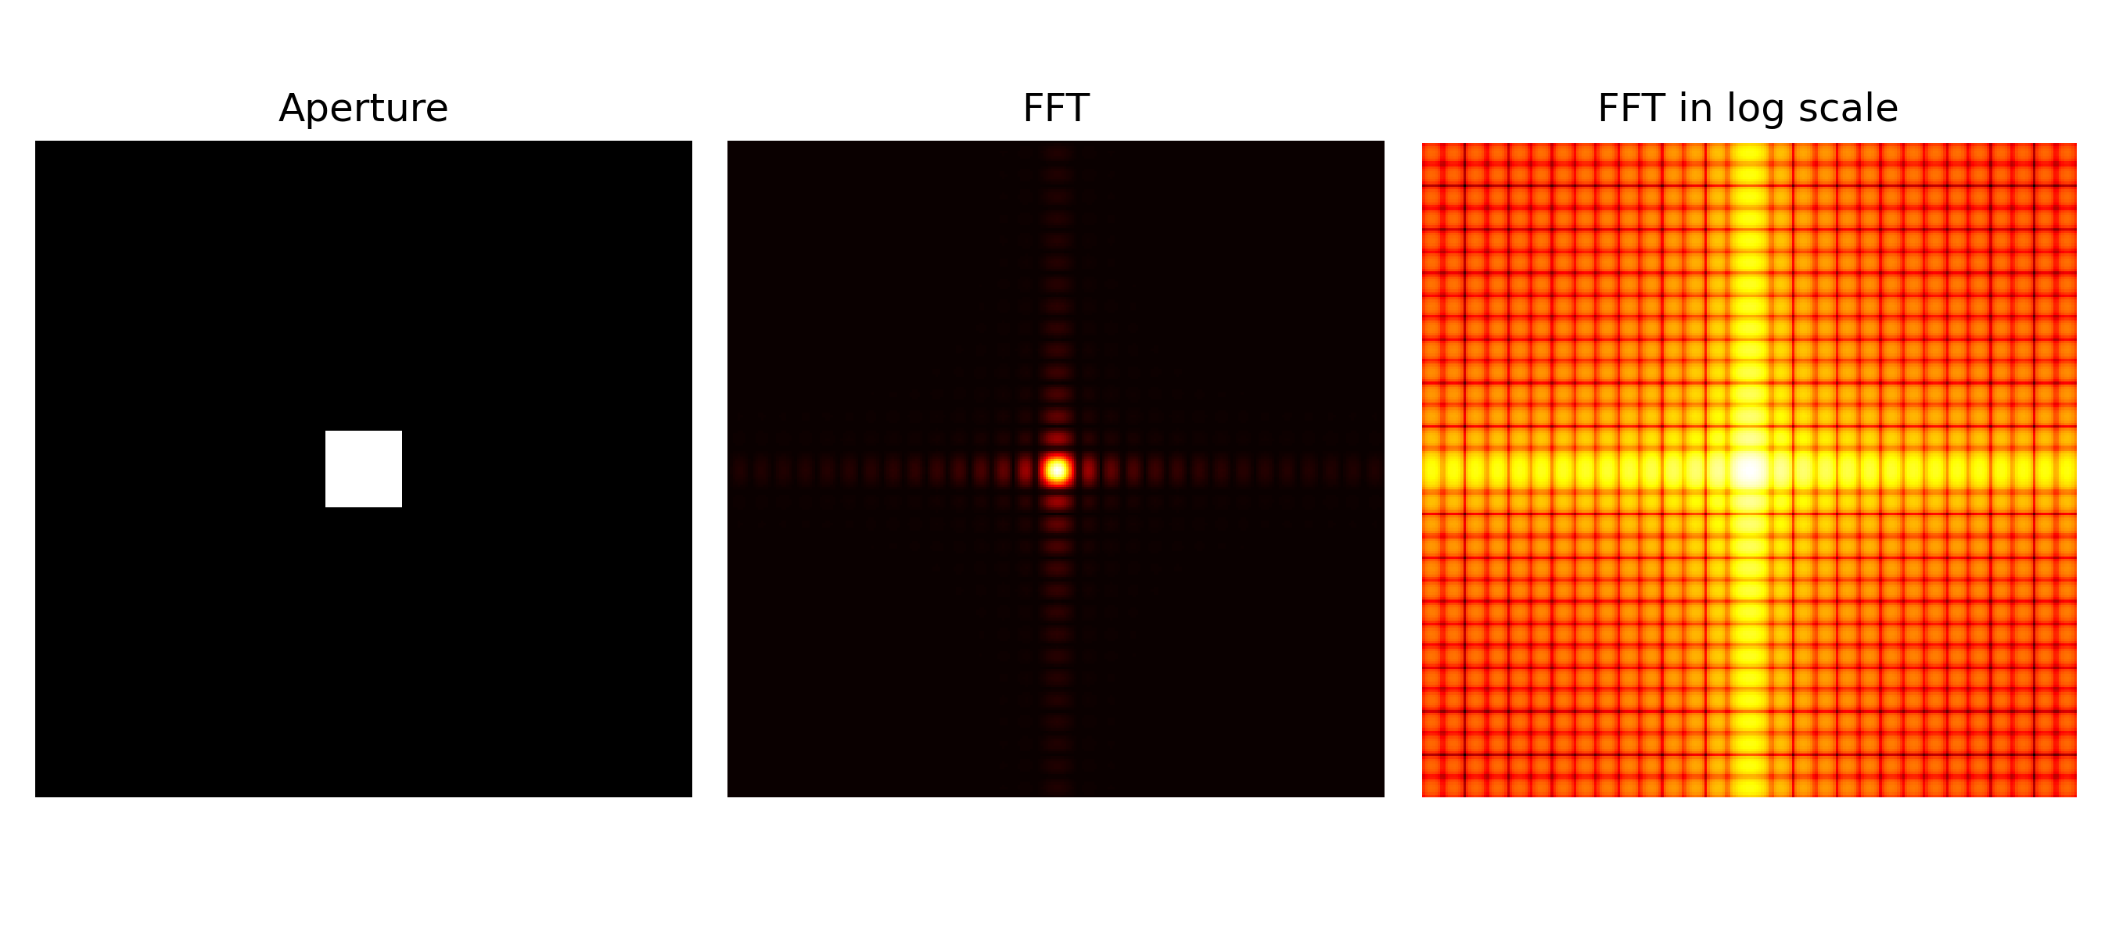
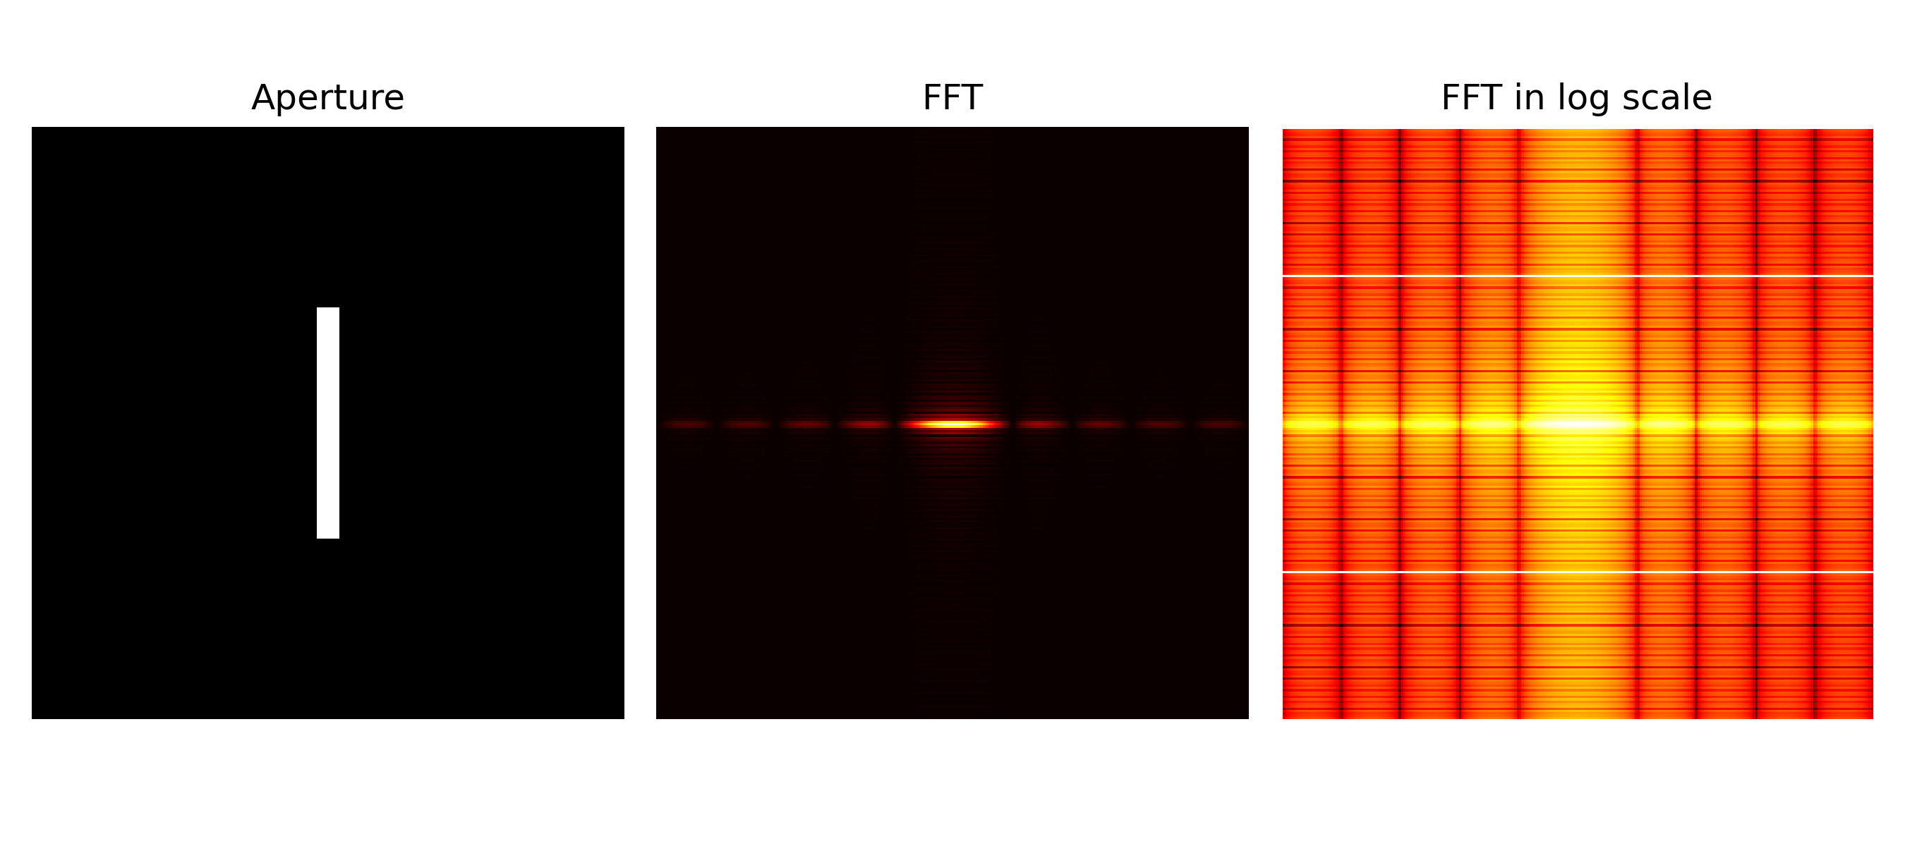
APP PHYSICS 157
FOURIER TRANSFORM MODEL OF IMAGE FORMATION
FAR FIELD DIFFRACTION PATTERNS
As described and modelled by Fraunhoffer diffraction
The first part of the activity involves the creation of synthetic images of apertures of varying shapes and sizes and taking its corresponding Fourier transform. We observe interesting diffraction patterns of such light beam, or monochromatic plane wave in general, as it strikes a given aperture, set in a 256 by 256 image resolution.
For brevity, the projected FFT of the aperture was also set in logarithmic scale to see the patterns explicitly. Some of the key results were shown on the right and on the next slides!

Slide 4
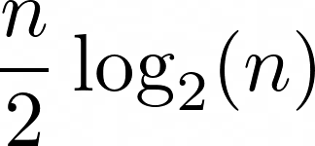
APP PHYSICS 157
FOURIER TRANSFORM MODEL OF IMAGE FORMATION
WHY DO WE USE 256 OR ANY 2^{N}?
The Fast Fourier Transform (FFT) is said to be the faster implementation of the Discrete Fourier Transform (DFT), for which the activity intends to simulate. In general, FFT algorithm reduces an n-point FT to about
complex multiplications. Since 256 data points were set for the images in this activity, the DFT calculation would simply go through the resolution by 256 times 256 or around 2¹⁶ multiplications. Comparatively, the FFT algorithm would only take, using the equation above, 1024 calculations only, which is faster by a factor of 64 times! These makes computations much faster for 2^{N} discrete points as it all boils down to the computer doing all the mathematical rigors with ease.

Slide 5
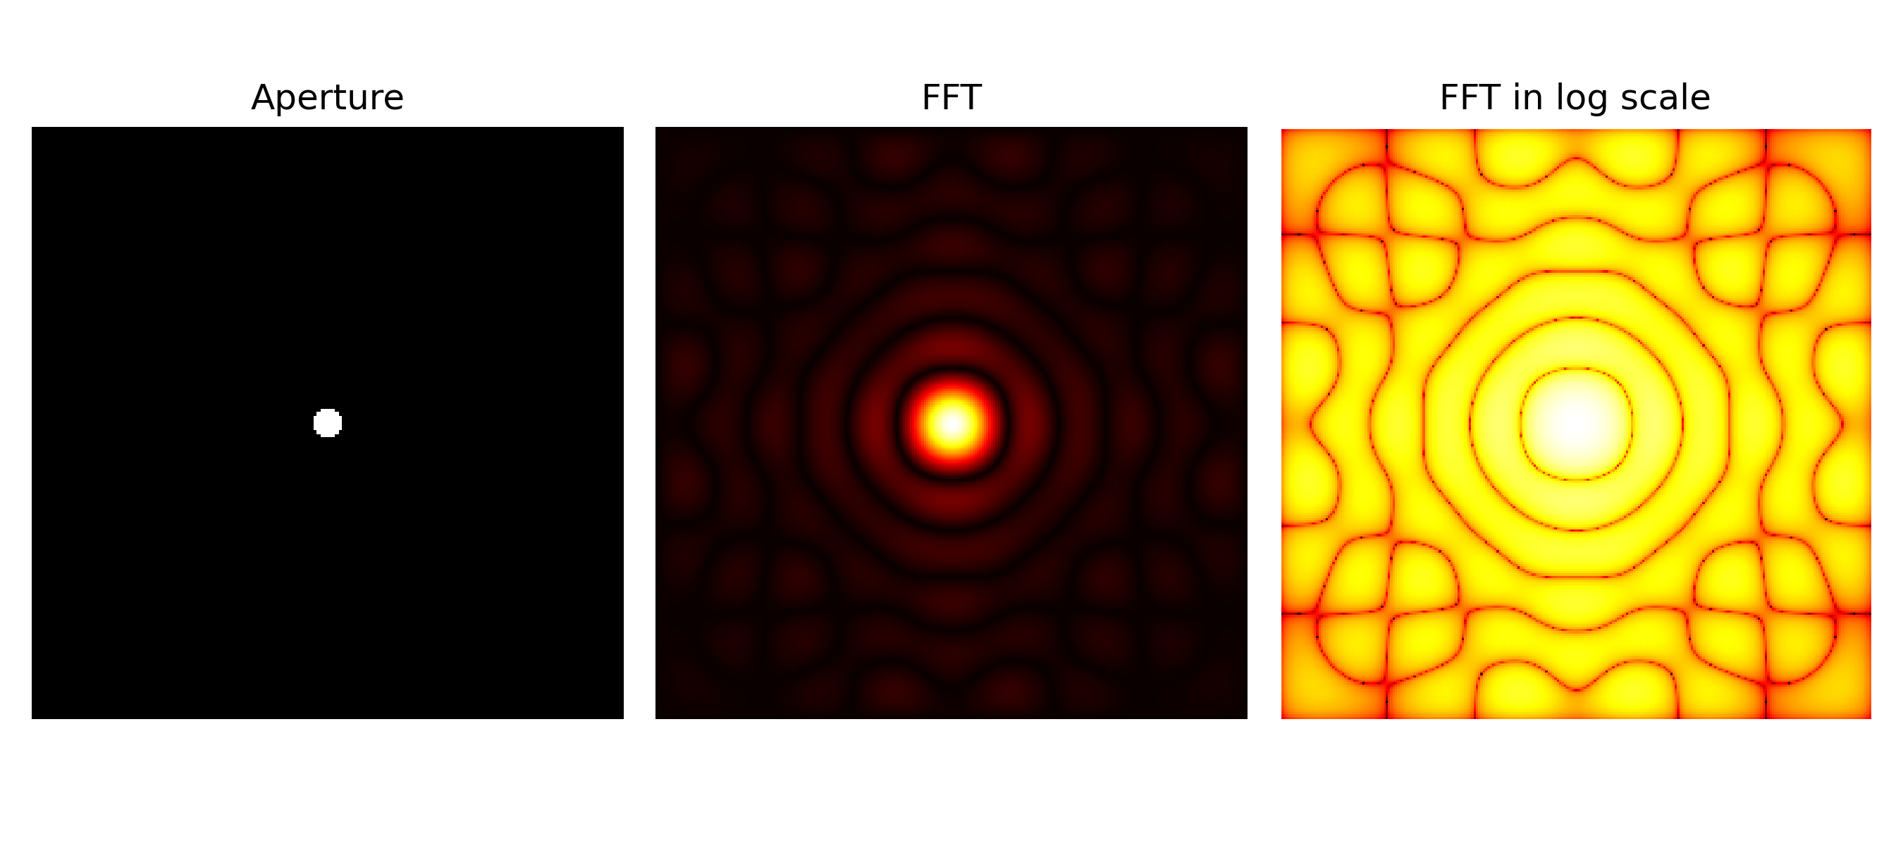
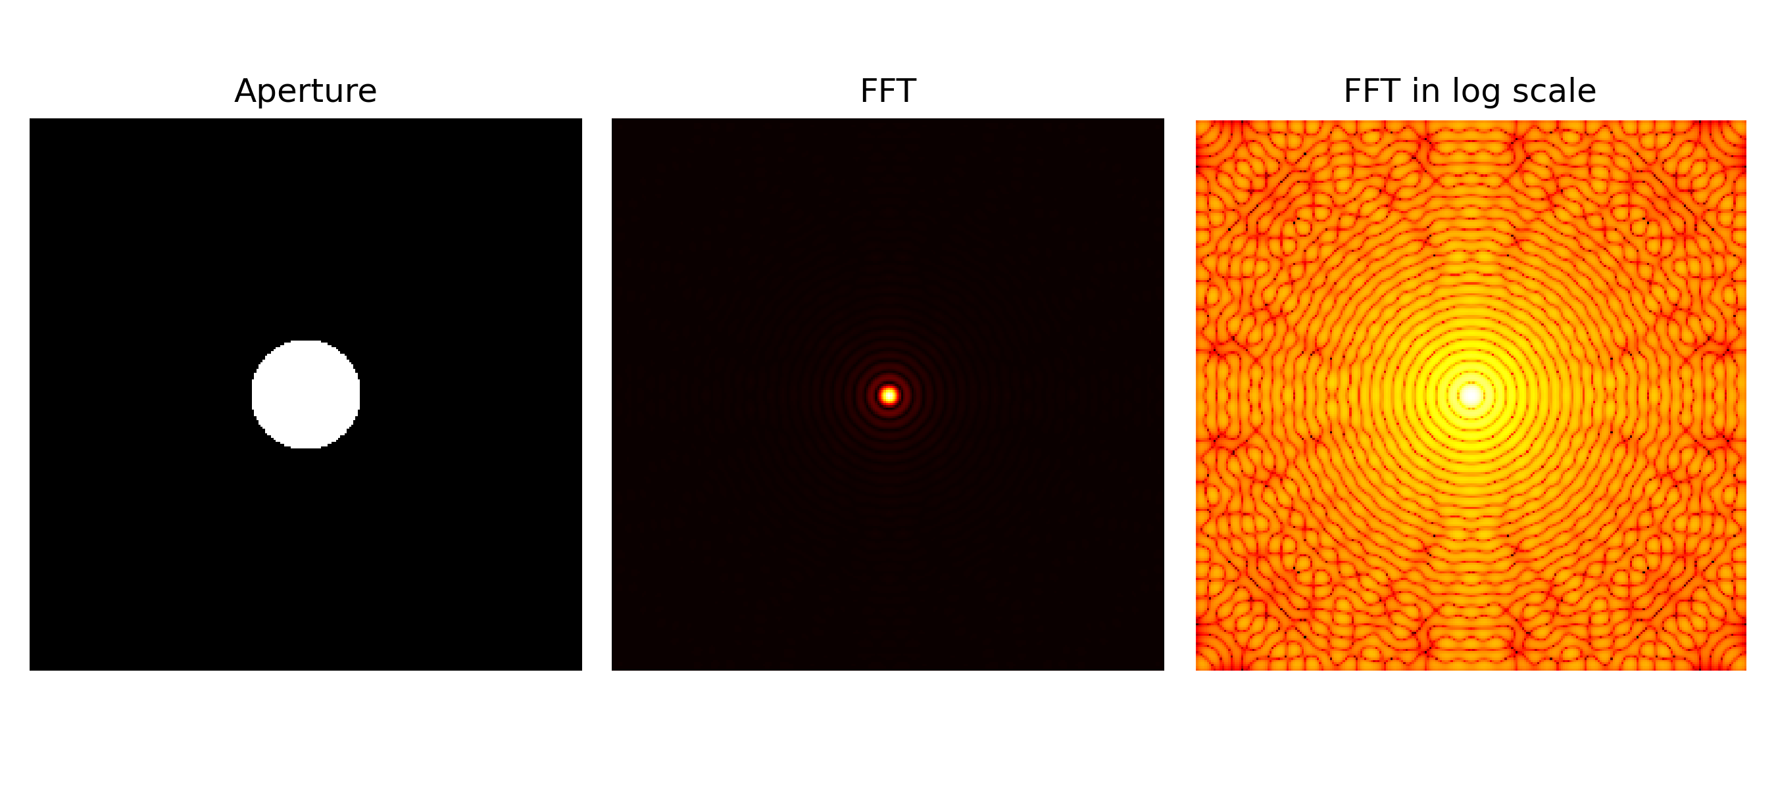
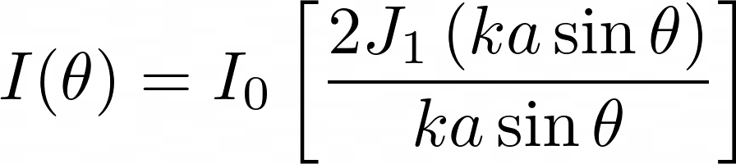
APP PHYSICS 157
FOURIER TRANSFORM MODEL OF IMAGE FORMATION
CIRCULAR APERTURES
Varying radii of circular apertures were considered, and it can be observed that the prominence of airy pattern decreases as the aperture radius increases. These airy patterns contribute to the extent of how light rays can get scattered as it passes through the said aperture, i.e. the radial patterns that propagate from the center represents the peaks at the real space domain. Interestingly, increasing the radius implies clearer image as the airy pattern diminishes. Hence, greater recovery on the details of an object is expected.
Figure 1. The FFT and FFT in log scale of circular apertures of varying radii.
As shown above, the diffraction pattern intensity for a circular aperture takes the form of a Bessel function, which is evident in the patterns in the logscale FFT. This special function usually arises in systems that invokes radial symmetry like in optical diffraction and similar optical systems.

Slide 6
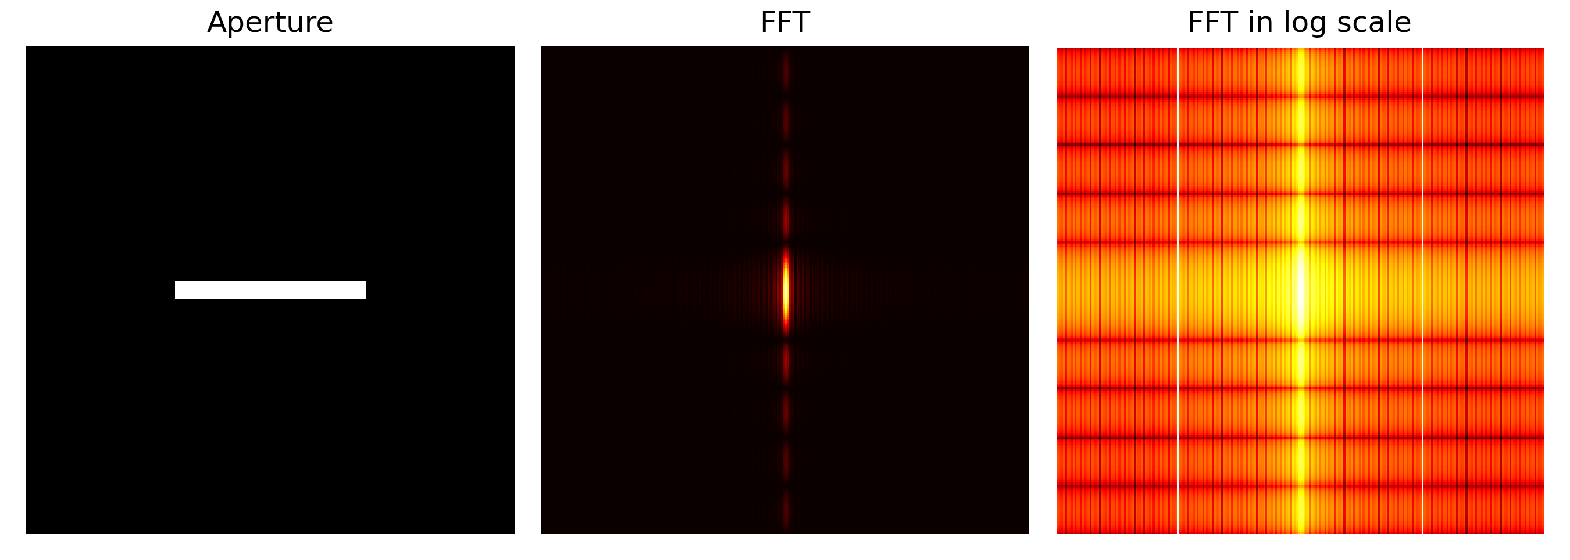
APP PHYSICS 157
FOURIER TRANSFORM MODEL OF IMAGE FORMATION
RECTANGULAR APERTURES
Other aperture geometry were also tried on for this activity. Rectangular apertures of varying widths and heights were prepared to resemble such single slit. The following observations were made as follows.
For a single slit oriented vertically, the resulting irradiance (FFT) was along the x-axis of the real plane, while the horizontal slit yielded a diffraction pattern along the y-axis. For both slits, the peaks in the Fourier space represent the bright streak of light along the center and faint spots on either side of the band.
For the special case of rectangular aperture --- a square aperture resulted into a two-fold symmetry with prominent square in the middle, and smaller less-intense squares coming off away from the center along both axes. These patterns for the three slits can be hypothesized as to why certain animals has wide range of peripheral vision, owing to their pupil shapes!
Figure 2. The FFT and FFT in log scale of single slits.

Slide 7
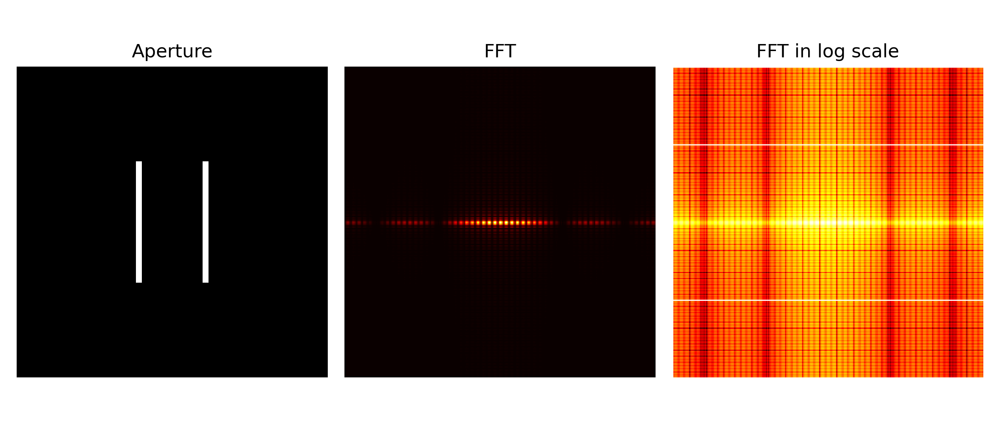
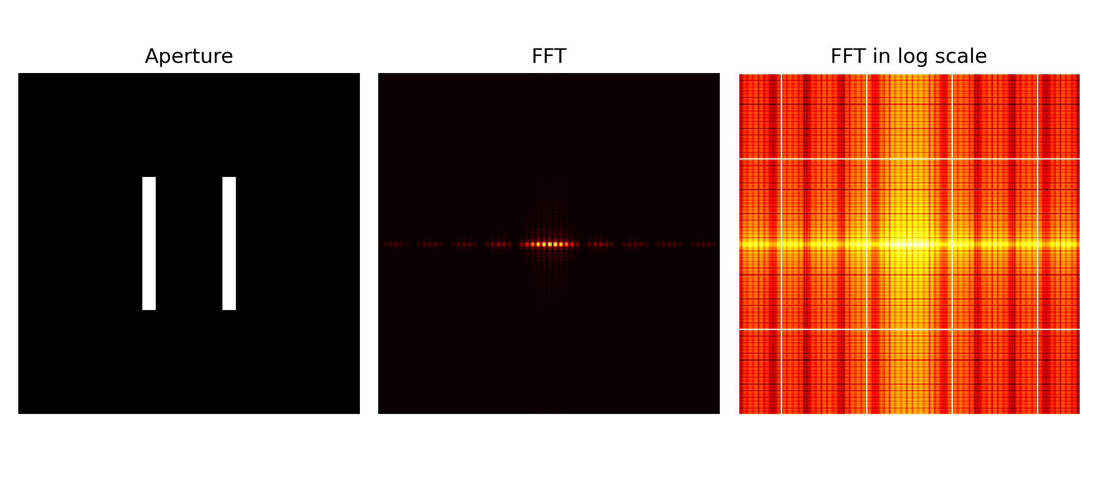
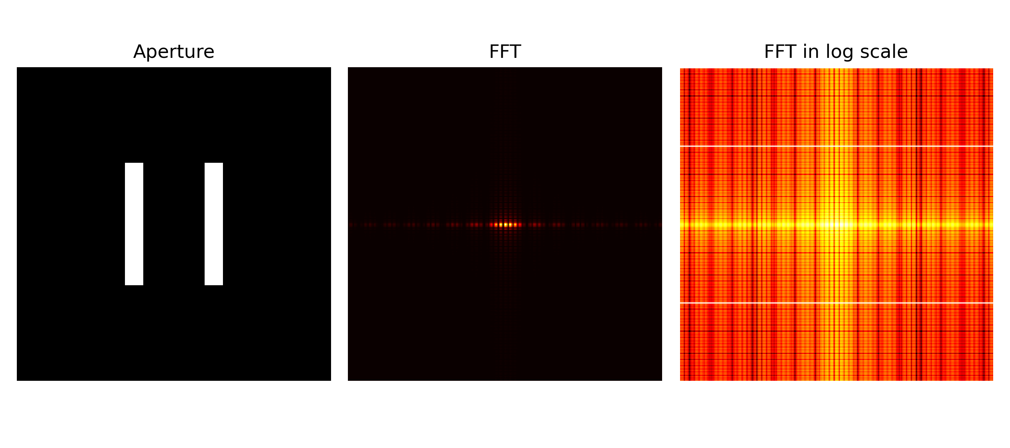
APP PHYSICS 157
FOURIER TRANSFORM MODEL OF IMAGE FORMATION
DOUBLE SLIT APERTURES
Given how the double slit interference pioneered the wave-particle duality of light, double slit apertures were also made to mimic this interesting phenomenon. Compared to the single slits, double slits have shown much smaller and several interference fringes on its diffraction pattern. As the slit width increases, the streak band in the middle decreases in size and so are the number of interference fringes.
Figure 3. The FFT and FFT in log scale of double slits of varying slit widths.

Slide 8
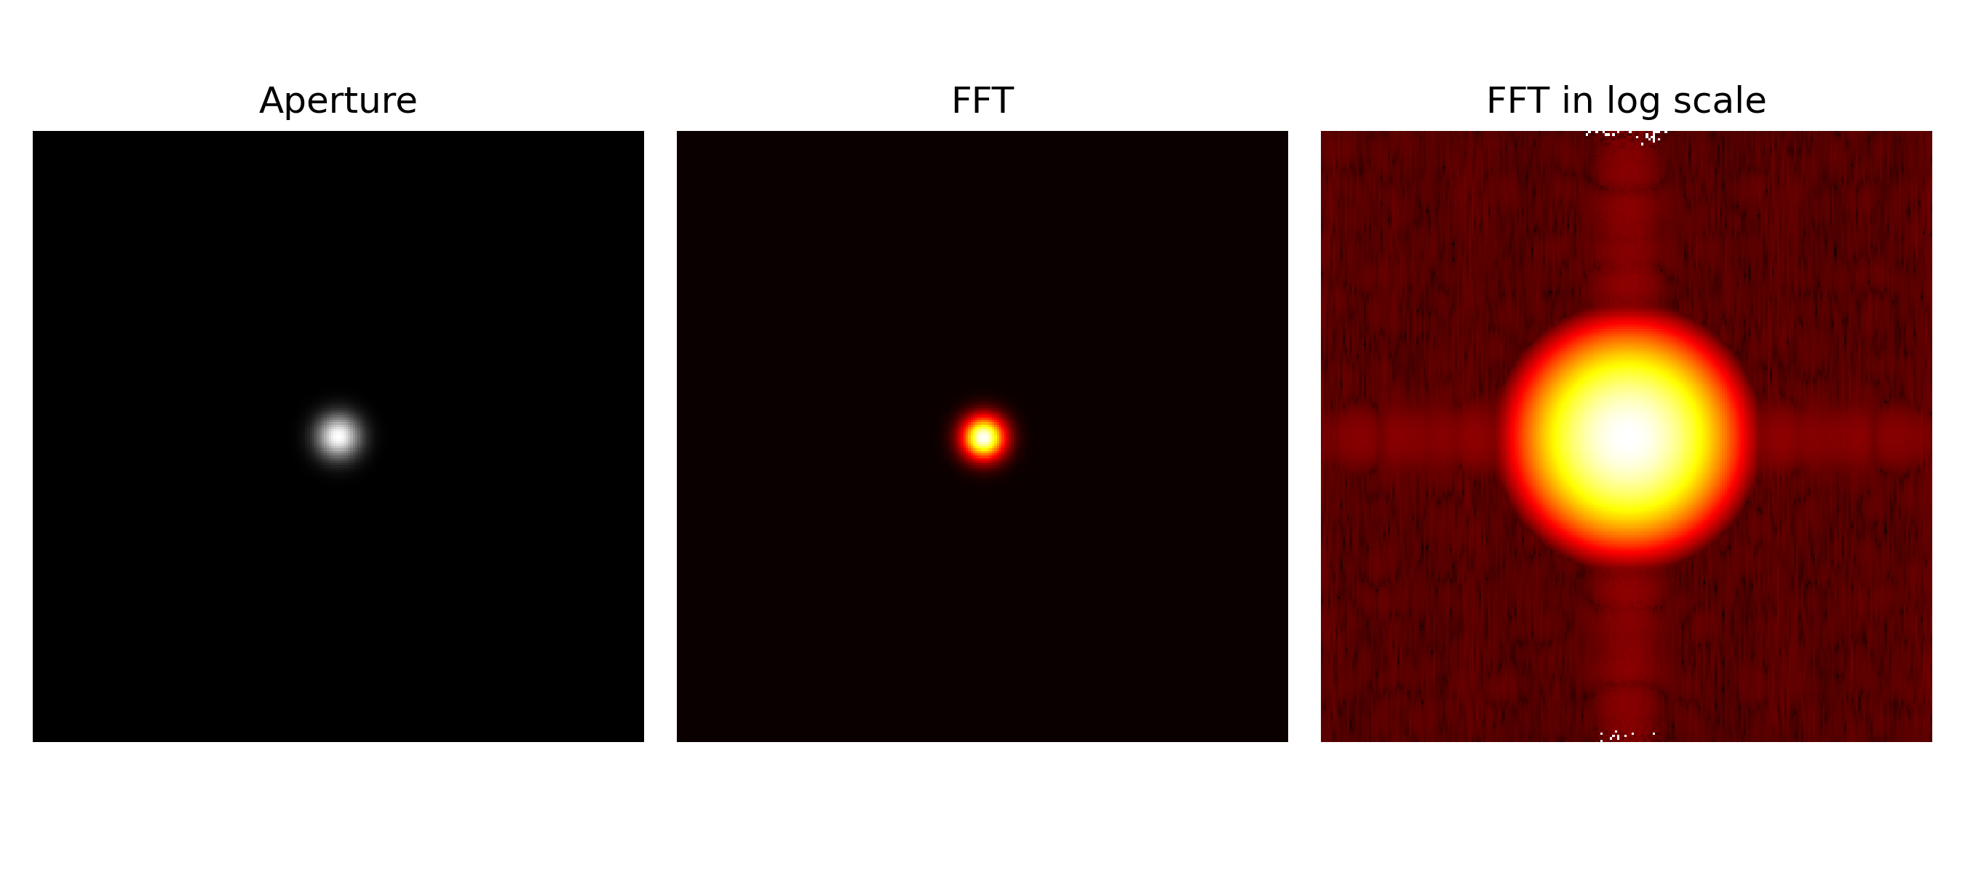
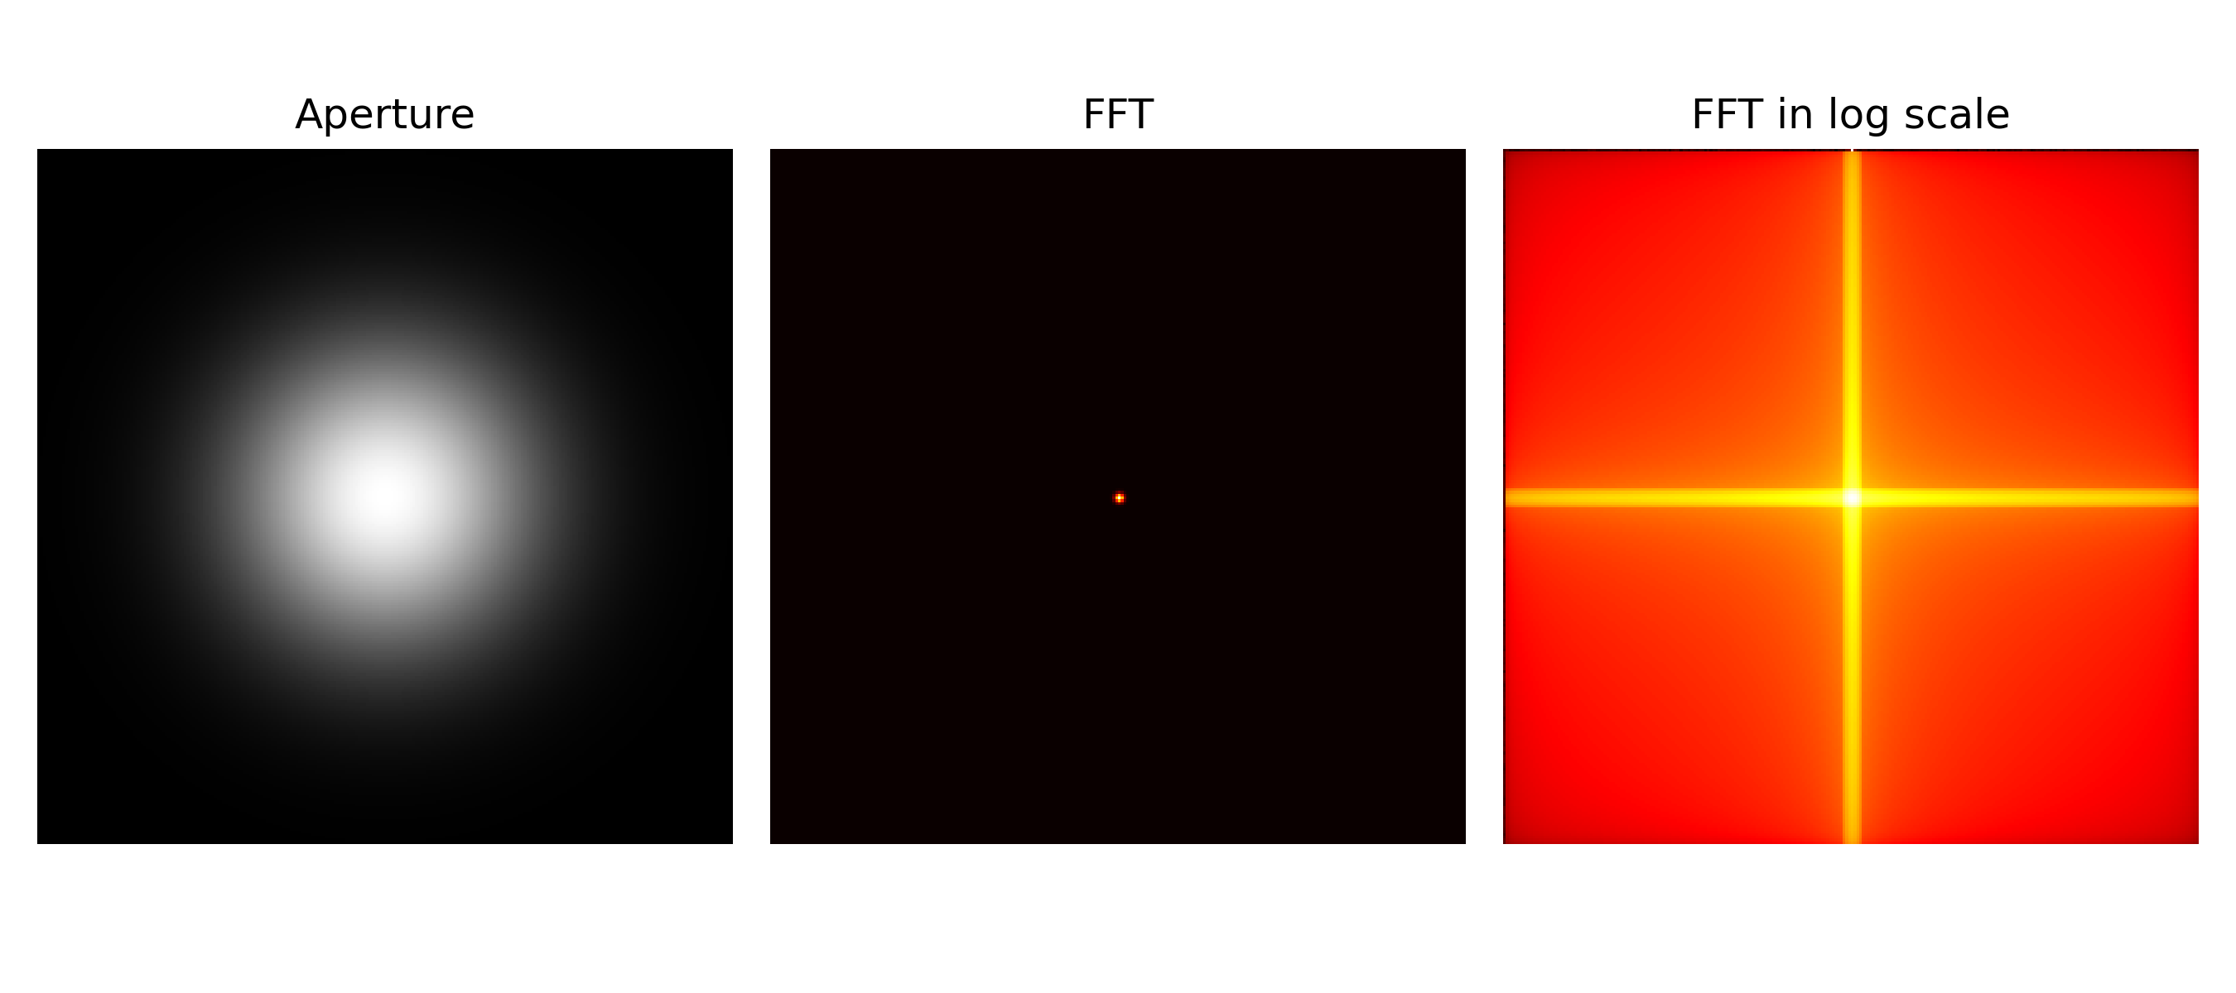
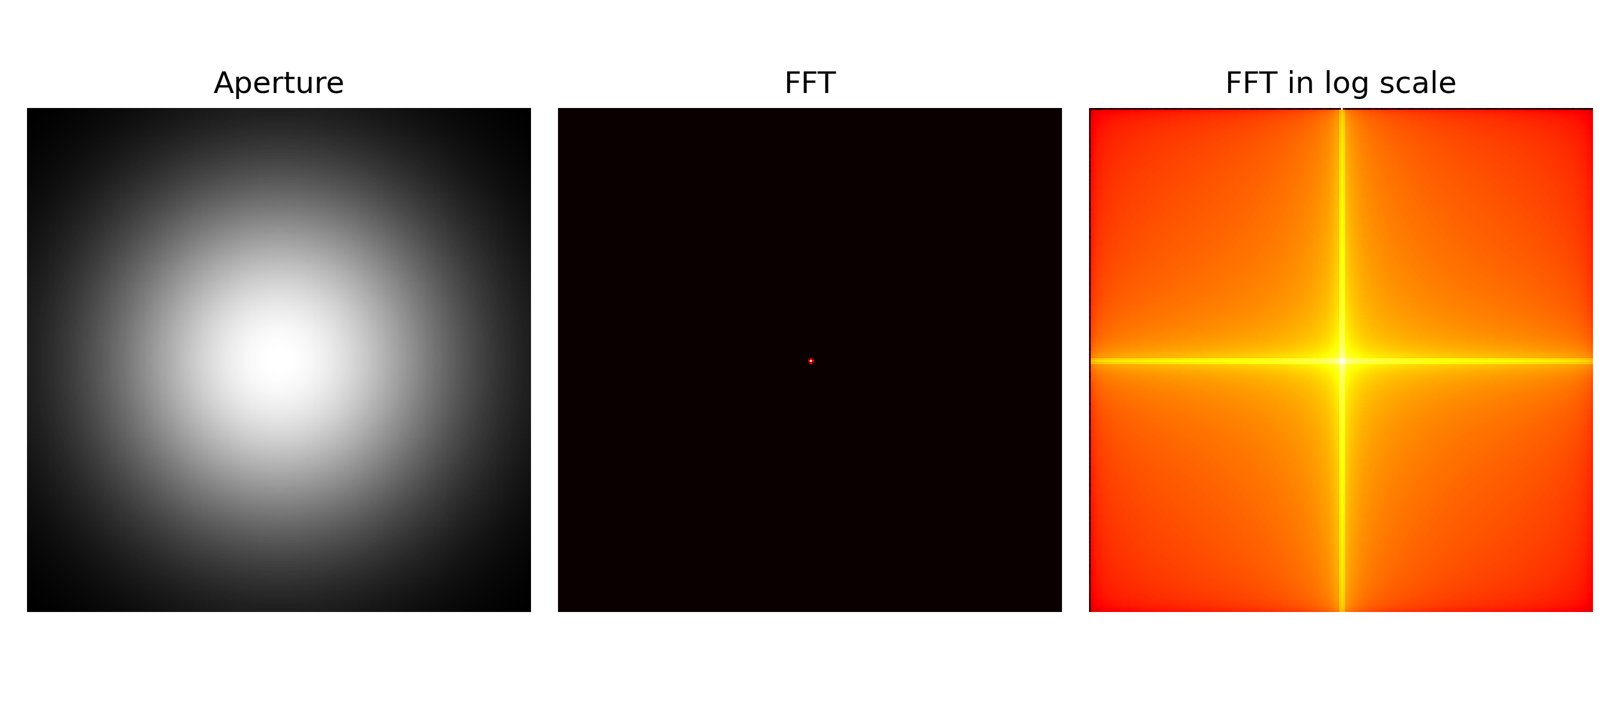
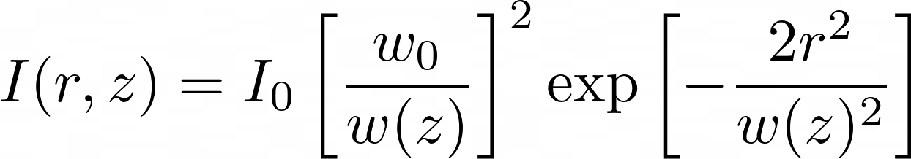
APP PHYSICS 157
FOURIER TRANSFORM MODEL OF IMAGE FORMATION
GAUSSIAN BEAM
A Gaussian beam of varying spread values were also made, and the resulting intensity profiles were also deduced to take the form of a Gaussian as well. This is an interesting property that holds in the field of optics as the linear transformation FT invokes on the aperture preserves its property of being a Gaussian, which can be attributed to its exponential factor.
For reference, the intensity profile of a Gaussian irradiance is given by
Figure 4. The FFT and FFT in log scale of Gaussian beams.

Slide 9
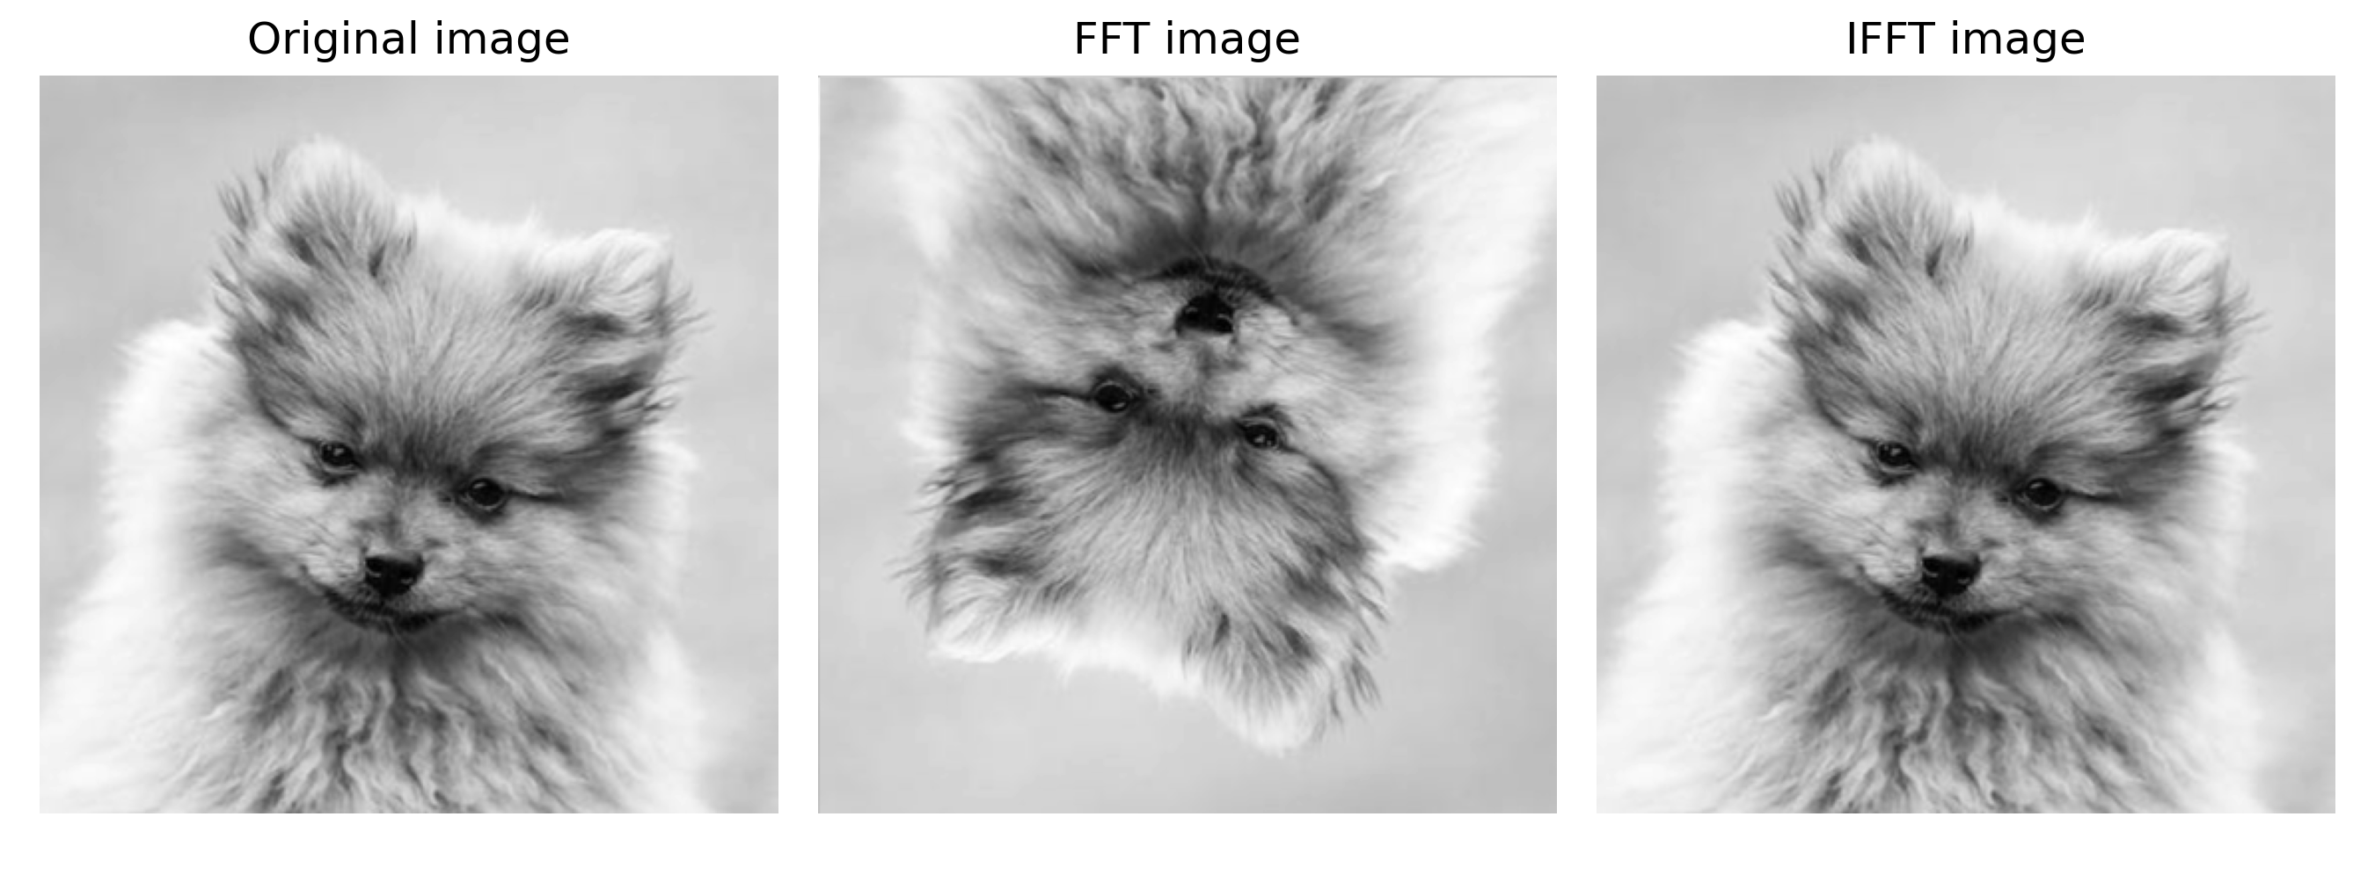
APP PHYSICS 157
FOURIER TRANSFORM MODEL OF IMAGE FORMATION
FFT AND IFFT ON IMAGES
Figure 5. Resulting images after applying FFT and IFFT to the grayscale image.
It was discerned that applying FFT2 twice to the image inverts it and applying IFFT2 to the FFT2-image reverts it back to its original appearance. On a mathematical standpoint, the grayscale image can be interpreted as a 2D array or signal in the Fourier space. Hence, applying FFT2 twice would correspond to the circular inversion of that array in space and taking the inverse FFT of an FFT2-array would simply revert it back to its original form in space. By these relations, it can be inferred that applying FFT2 to the original image four times successively will always result to the original orientation of the image.

Slide 10
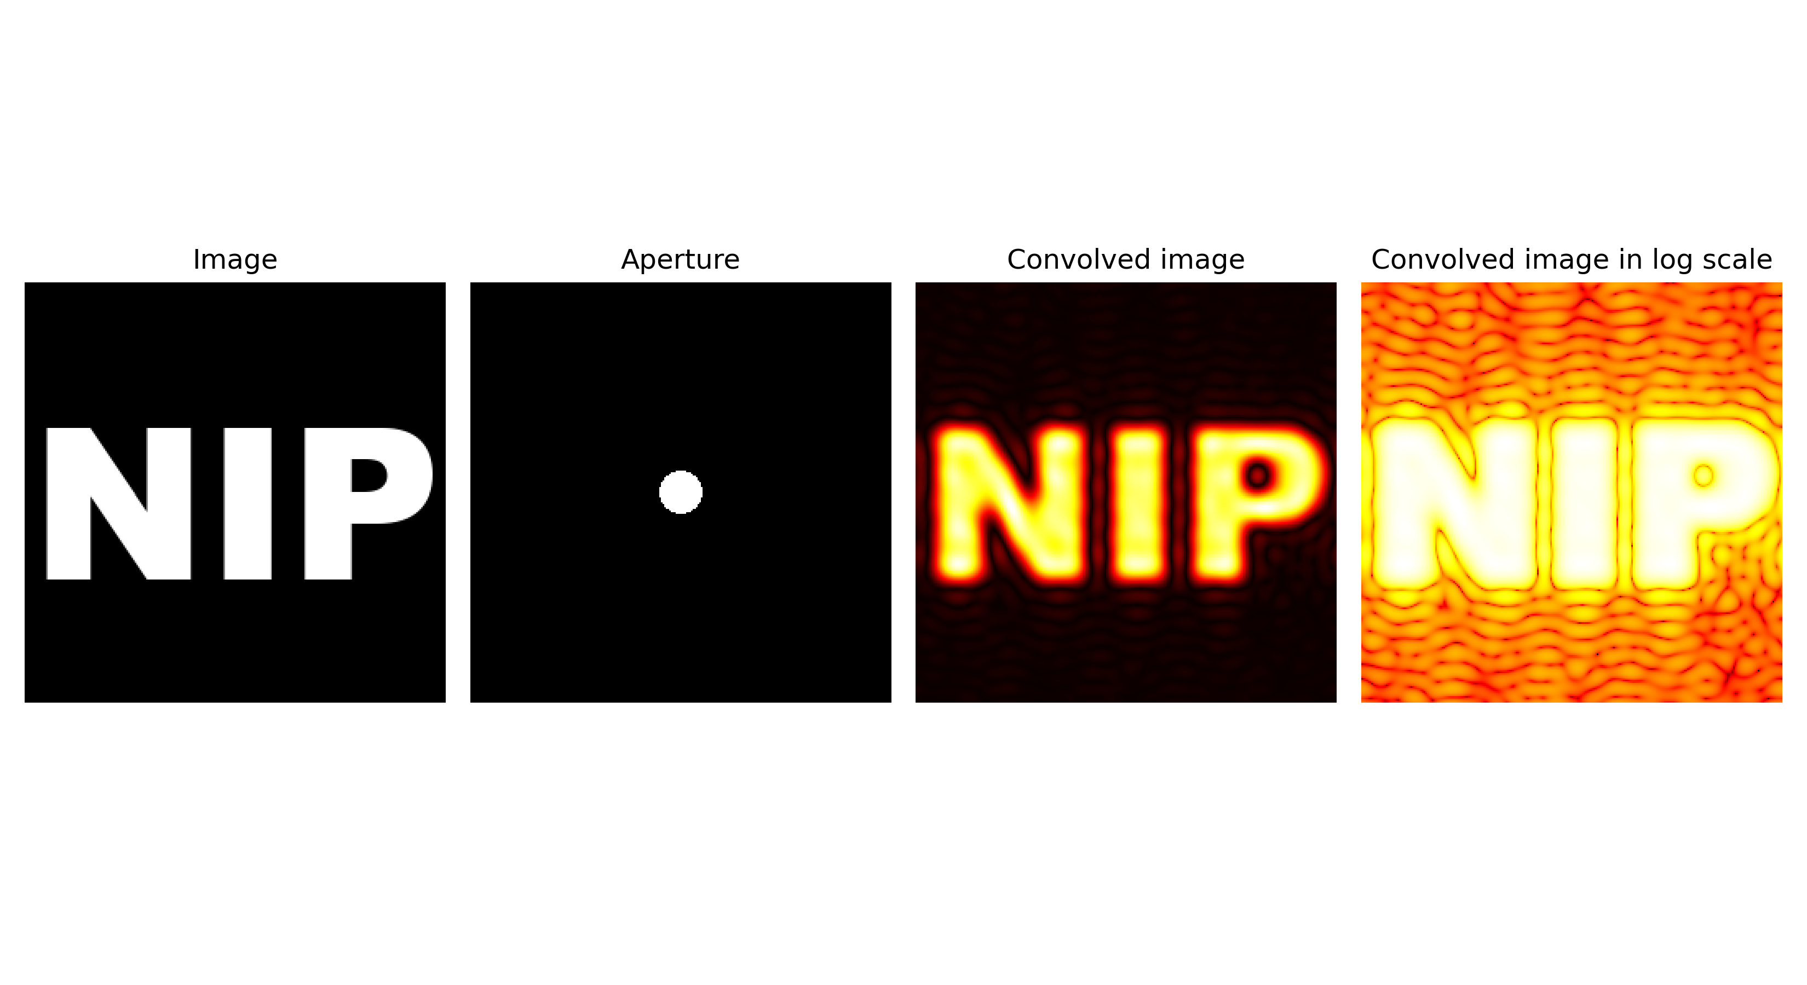
APP PHYSICS 157
FOURIER TRANSFORM MODEL OF IMAGE FORMATION
IMAGE CONVOLUTION
In theory, the convolution between two-dimensional function reads as
by which it can be interpreted as a smearing of one function against the other such that the resulting function bears a resemblance of both the input functions. In imaging, convolution governs systems where an aperture is used to project an object such that the resulting image will be the view when that object is beheld in front of the aperture. A good visualization of this is shown below where the resulting (convolved) image is like how one would perceive it when the text is viewed on the circular aperture!
Figure 6. The FFT and FFT in log scale of double slits of varying slit widths.

Slide 11
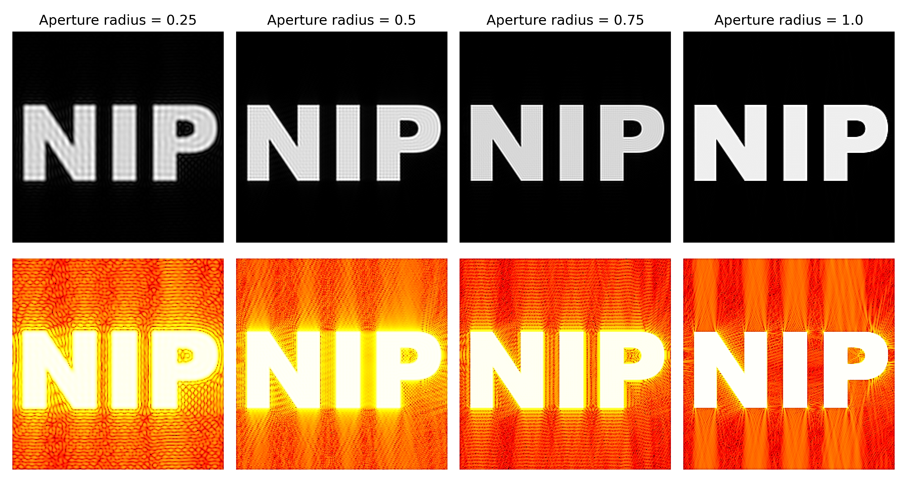
APP PHYSICS 157
FOURIER TRANSFORM MODEL OF IMAGE FORMATION
SIMULATION OF AN IMAGING SYSTEM
The second part of the activity intends to simulate various imaging systems using the underlying concepts introduced in the previous activities. For imaging systems that use circular lens as an aperture, the resulting image solely depends on the finite size of the camera lens as shown below.
Figure 7. The convolved image of the text for circular apertures of varying radii.
Observe how the increasing radii of the aperture increases the image clarity as the airy patterns diminish. As expected, greater recovery on the object details were acquired for larger radii. On the discussion on circular apertures, these airy patterns are prominent on smaller radii since small bundle of rays that reflect off an object can only be gathered. Hence, the image of an object is not as perfect resemblance compared to larger apertures.

Slide 12
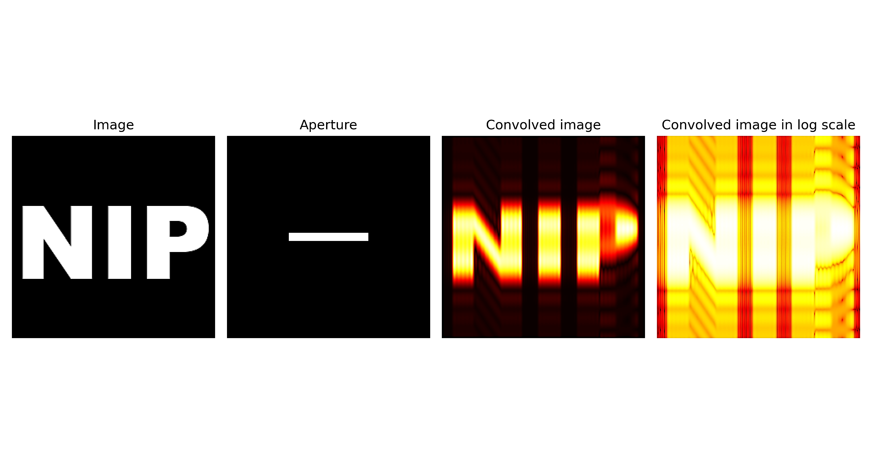
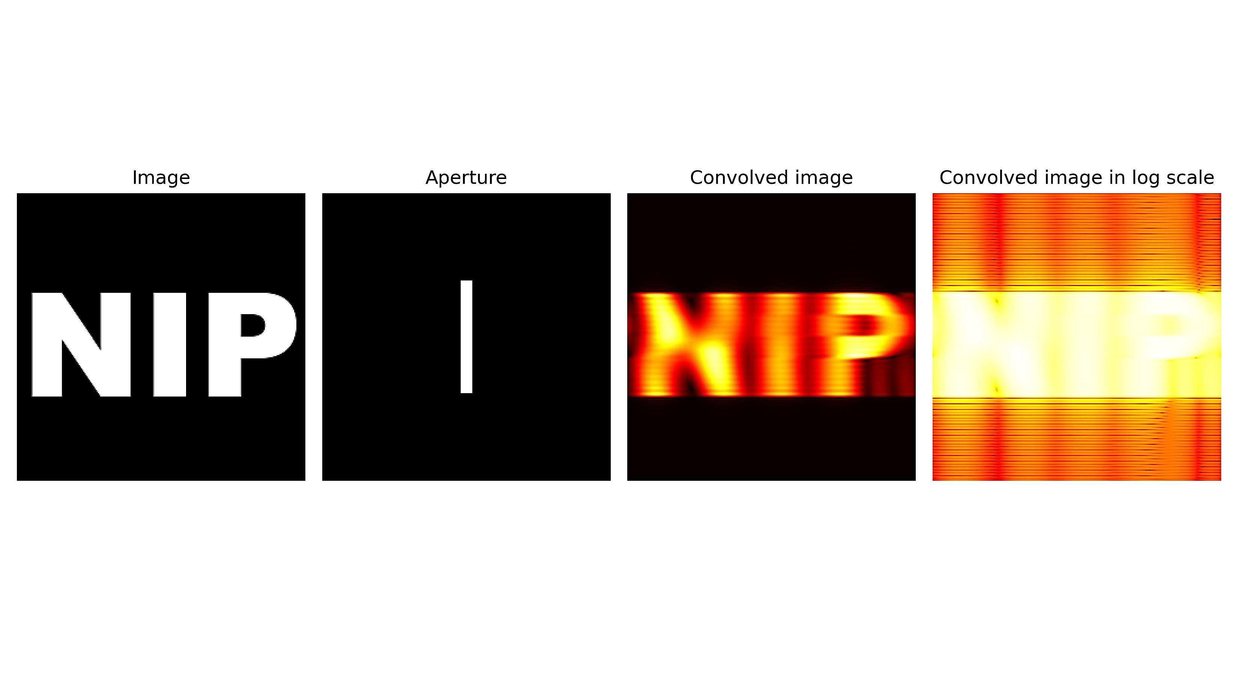
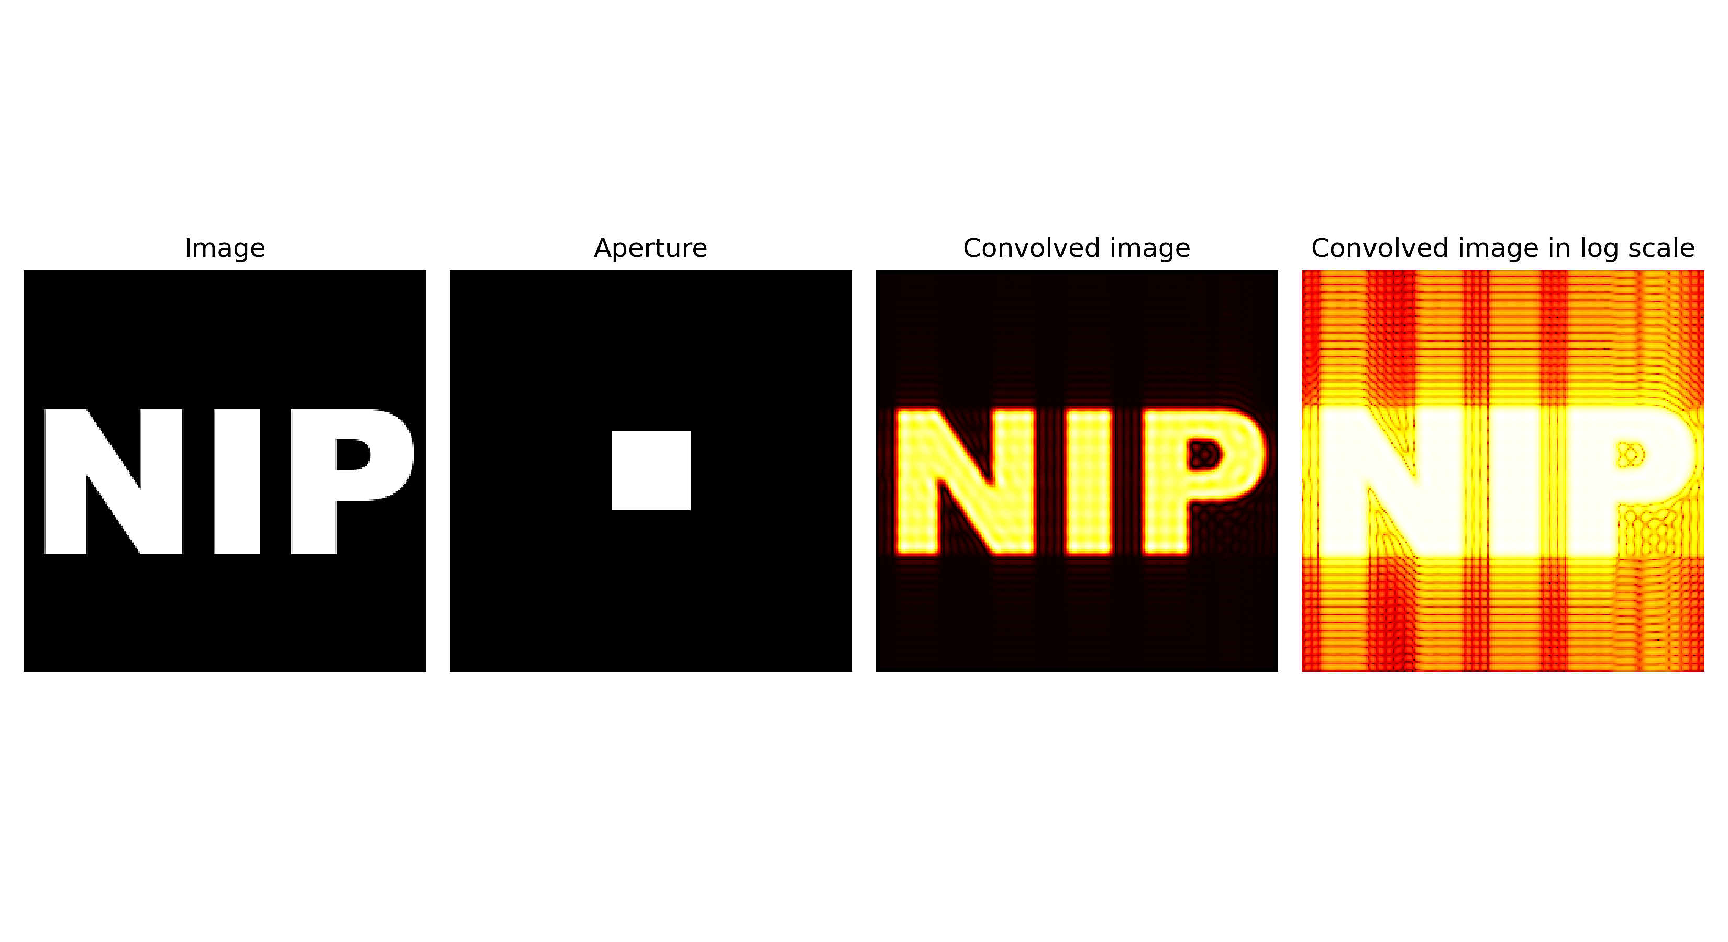
APP PHYSICS 157
FOURIER TRANSFORM MODEL OF IMAGE FORMATION
Figure 8. The convolved images using the apertures used in the previous activity.
The resulting images when convolved with the different apertures made in the first activity were parallel to how light is diffracted on the single slits. The interference patterns are much more evident in the logarithmic scale for reference.

Slide 13
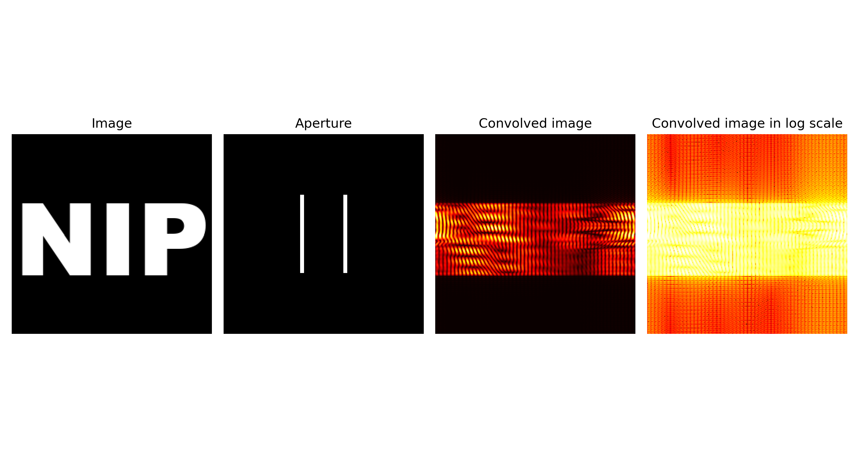
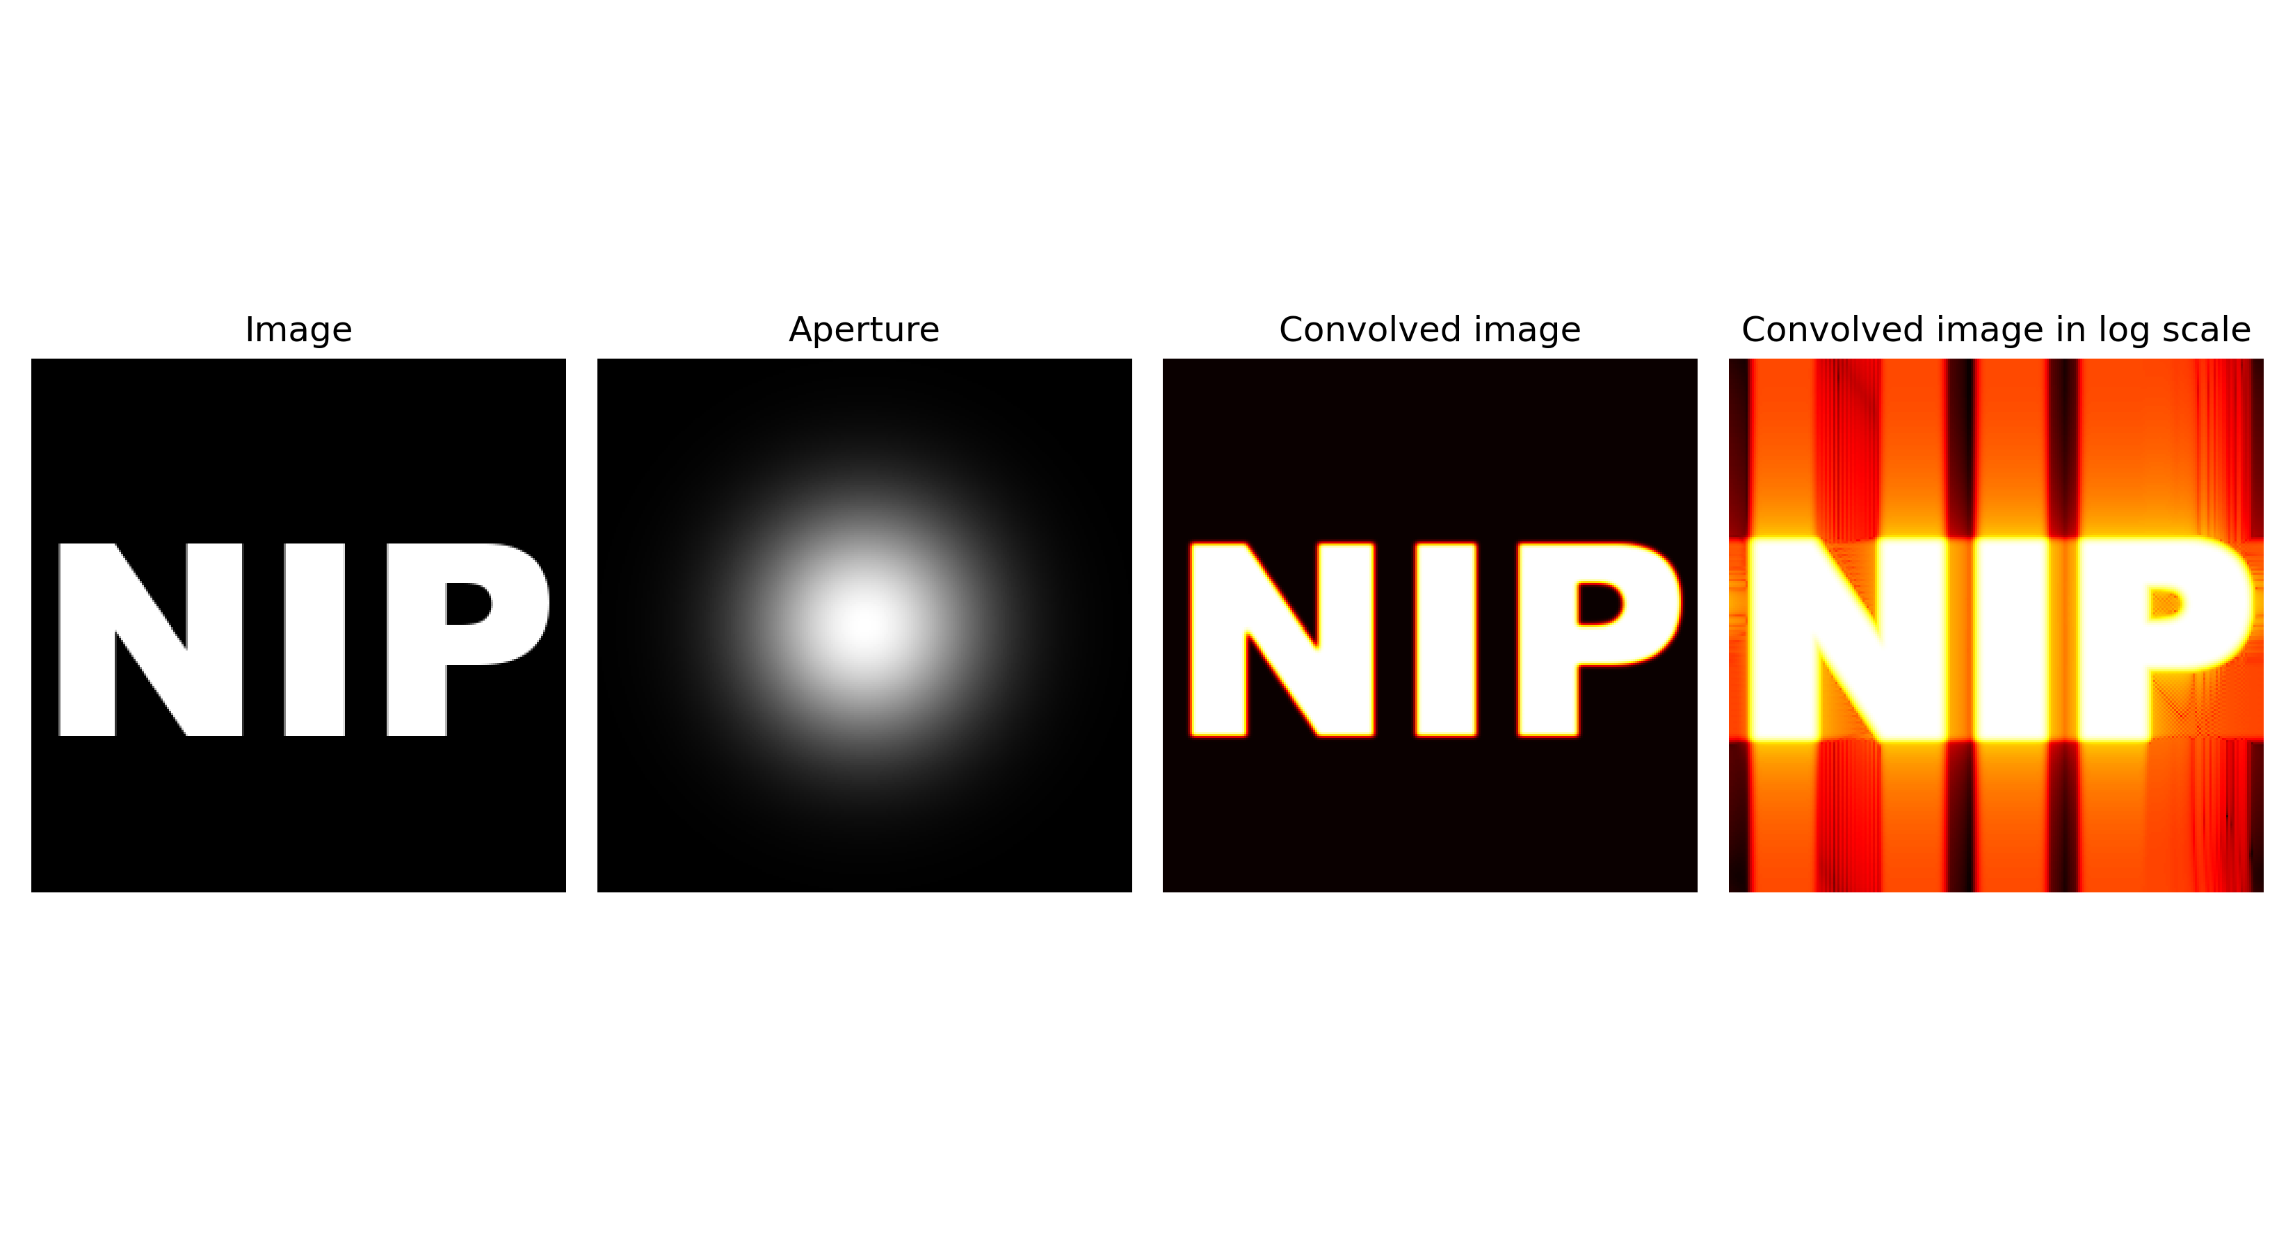
APP PHYSICS 157
FOURIER TRANSFORM MODEL OF IMAGE FORMATION
Figure 9. Convolved image with a double slit aperture.
The resulting convolved image for a double slit is dominantly made up of interference fringes, making the NIP text indistinguishable. Similarly, a gaussian beam was also tried as shown in Figure 10.
Figure 10. Convolved image with a gaussian beam.
No changes on the convolved image were deduced as the FFT of a Gaussian beam is still Gaussian!

Slide 14
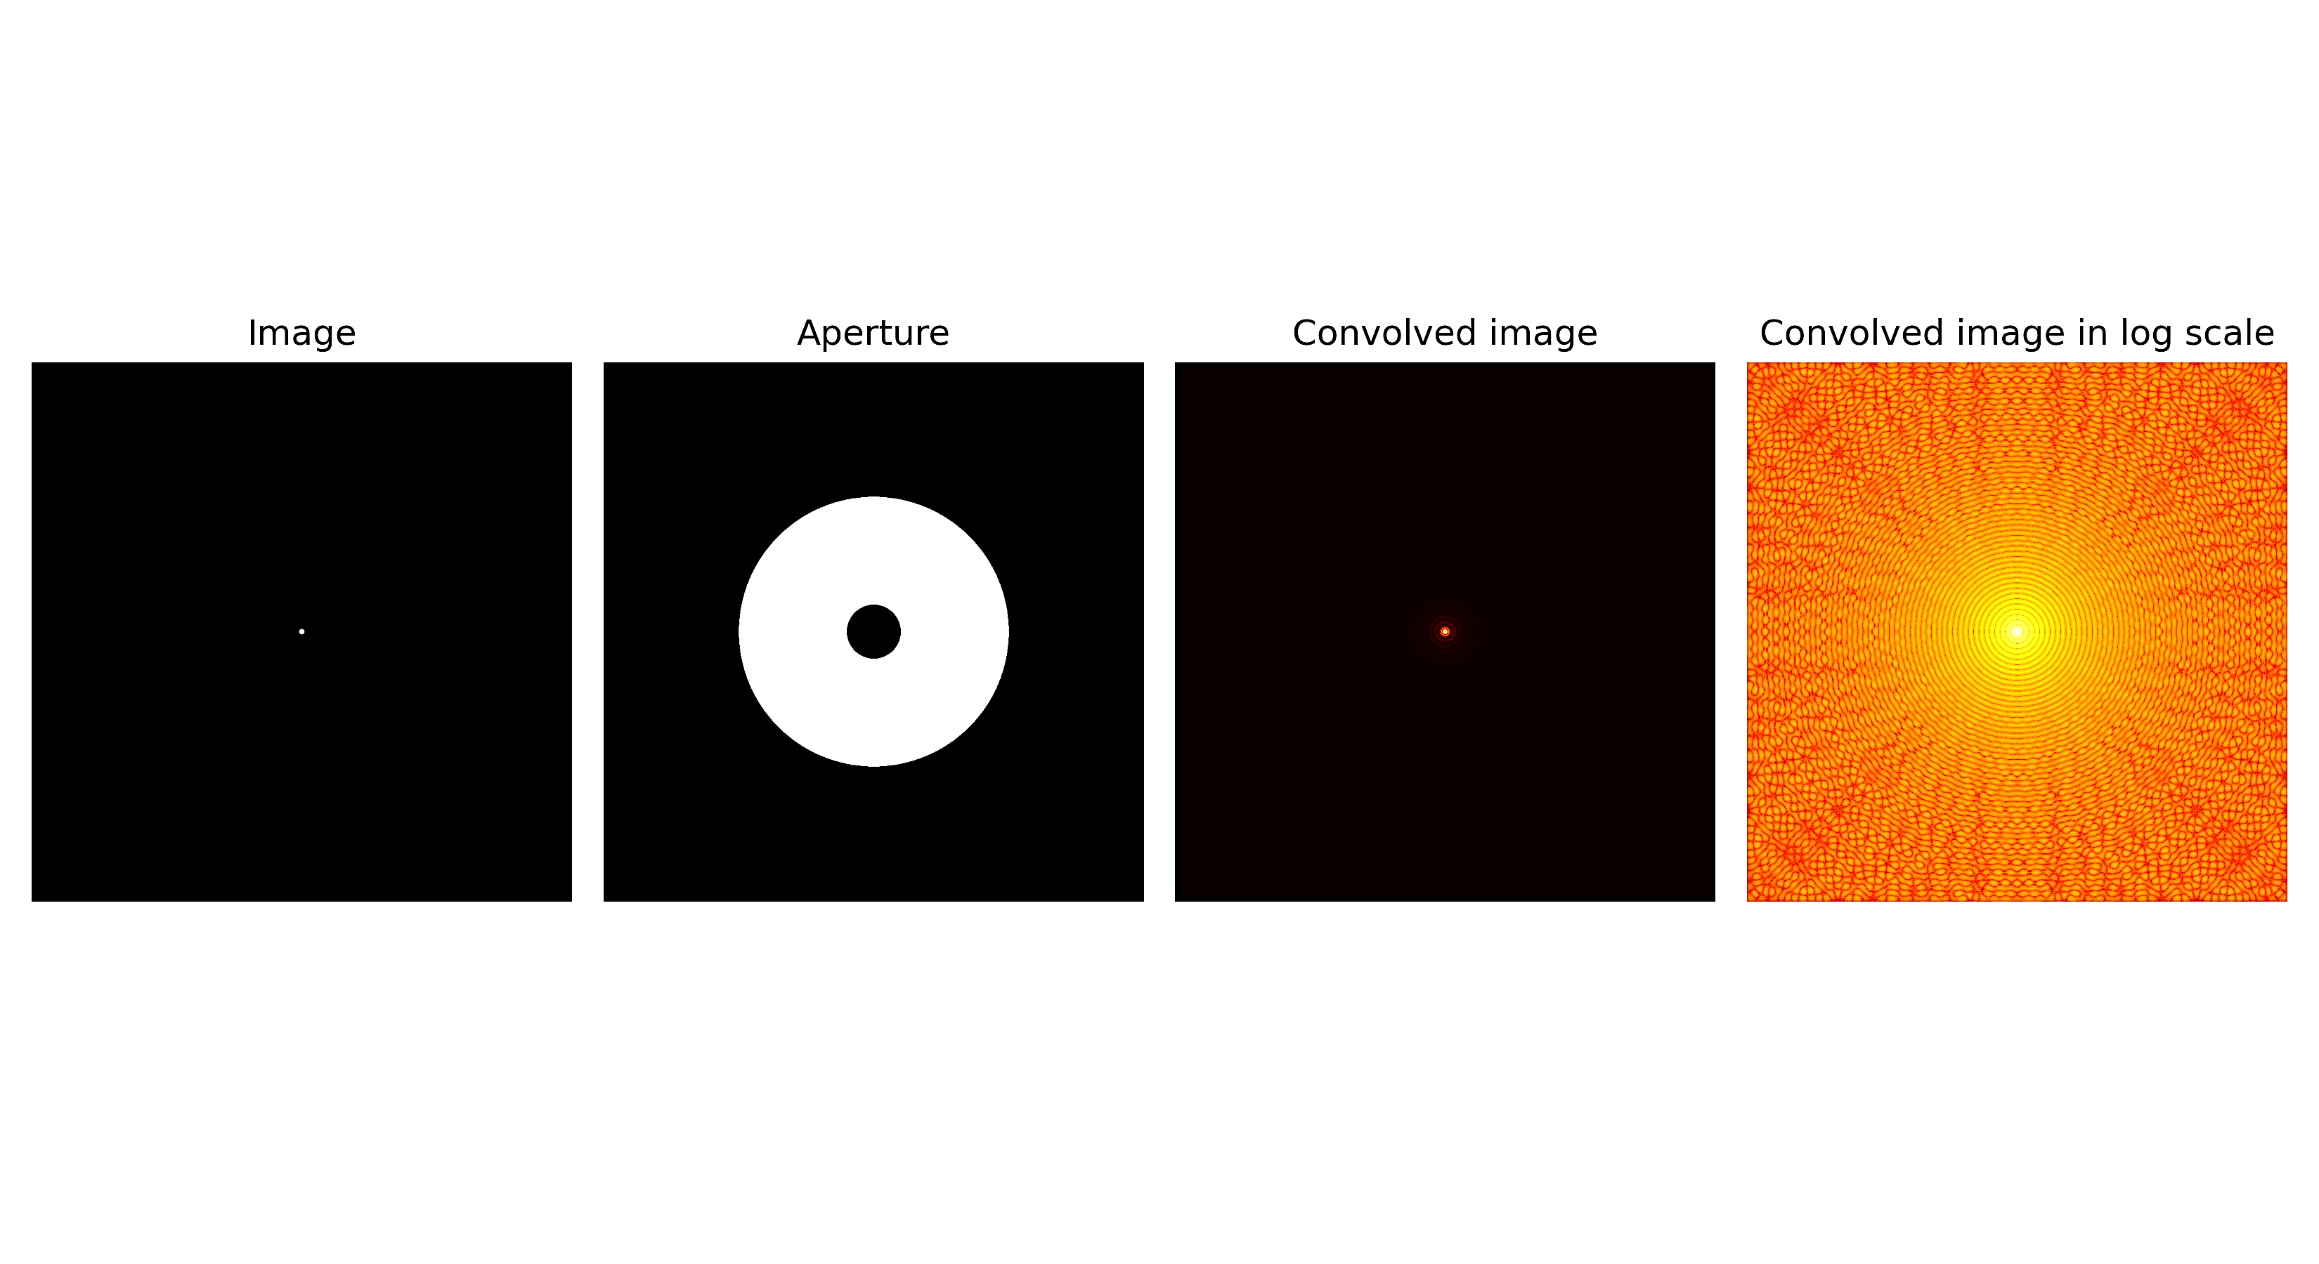
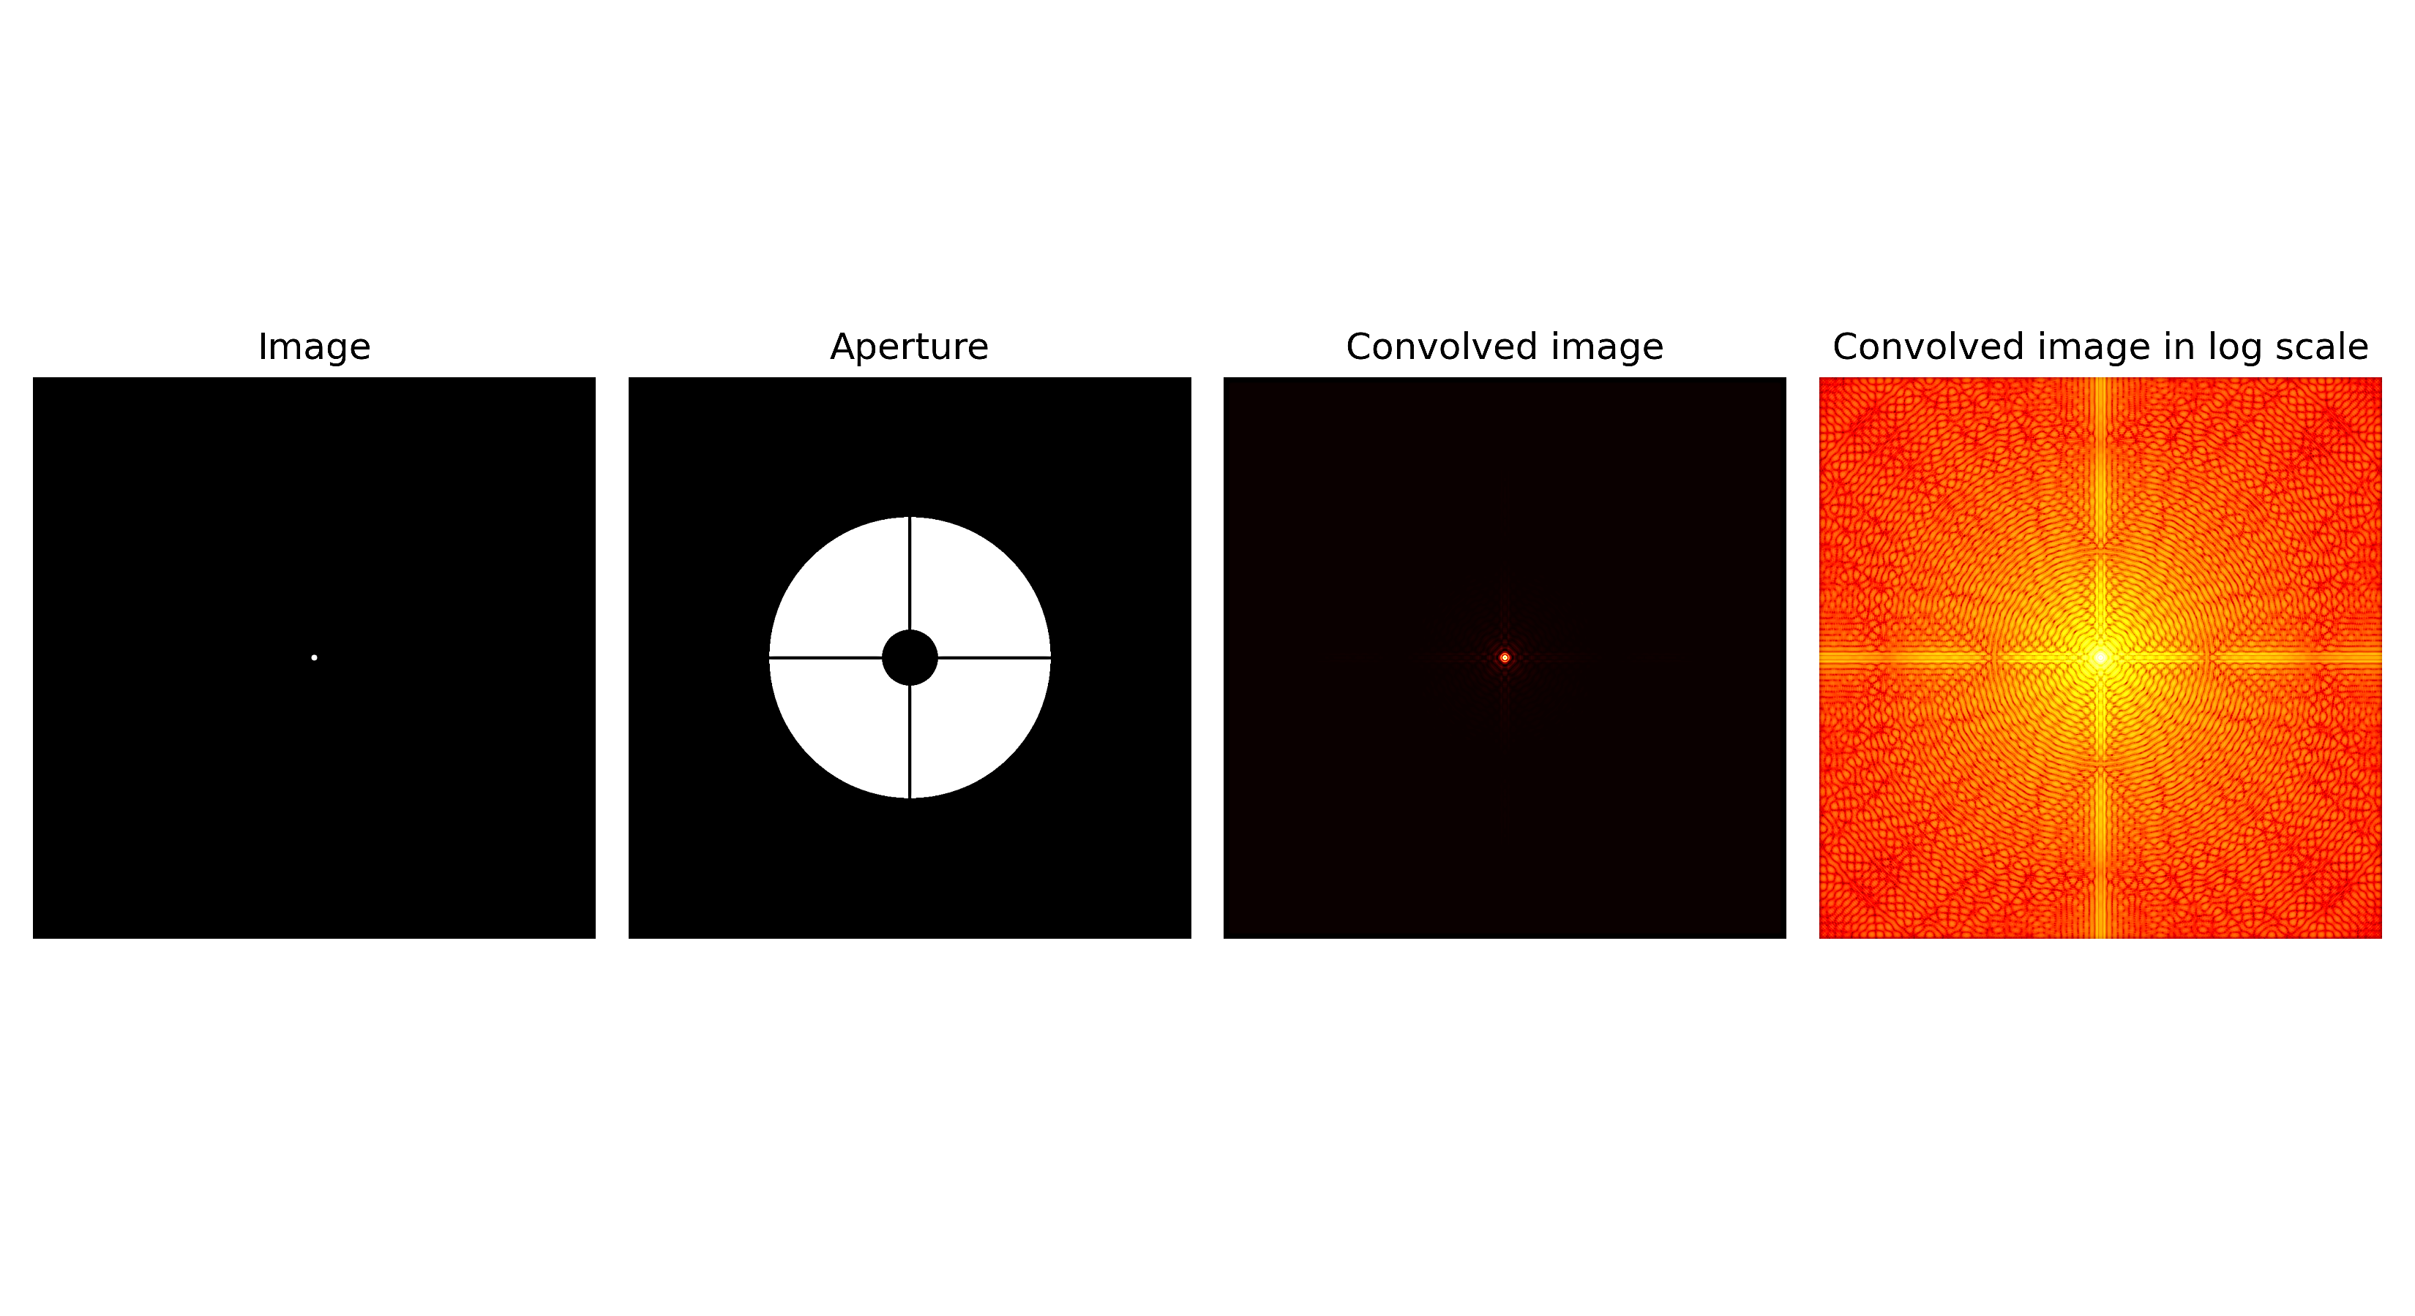
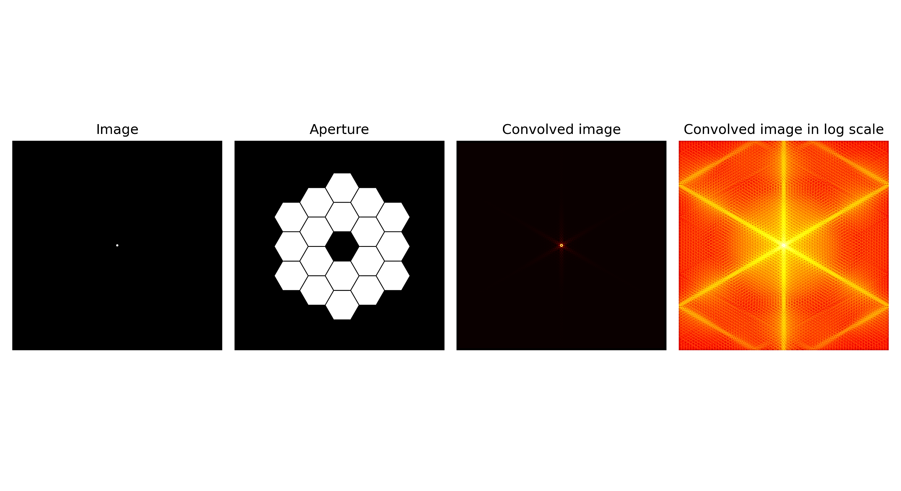
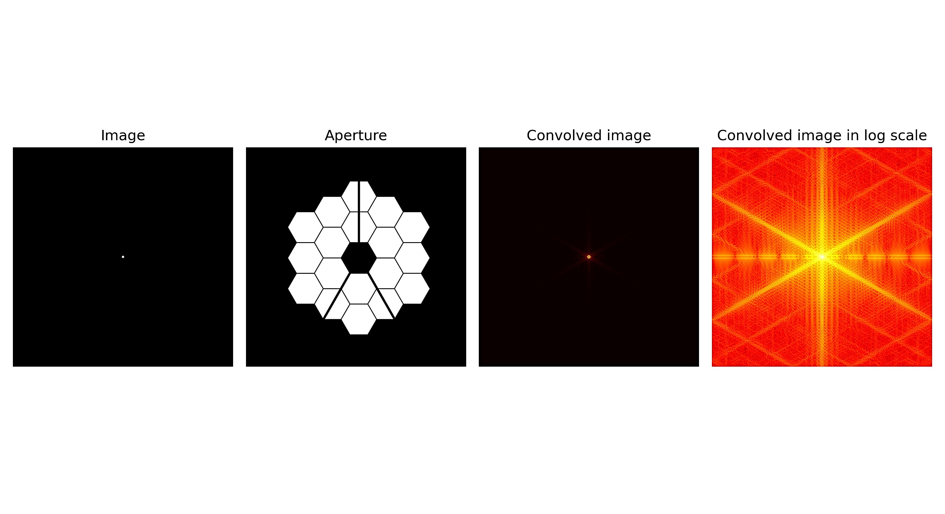
APP PHYSICS 157
FOURIER TRANSFORM MODEL OF IMAGE FORMATION
IMAGING ON SPACE TELESCOPES
Analysis on the Hubble Primary Mirror (1990) and James Webb Telescope (2021)
One of the interesting real-life applications of image convolution goes to the simulation of how light from the stars look like when reflected by these space telescopes.
Using the apertures created in the first activity, an image of a star, like a point, is convolved with the telescope assembly. The resulting images are the convolution of the two and it closely models the appearance of an image captured by these telescopes in general.
For most reflecting telescopes like the Hubble and Webb, the diffraction spikes are produced as light from the stars strikes the main mirror and its struts that support the assembly. But how does this exactly happen?
Figure 11. Comparison between the Hubble and James Webb space telescopes with no struts and with the presence of struts in the assembly.

Slide 15
APP PHYSICS 157
FOURIER TRANSFORM MODEL OF IMAGE FORMATION
ANALYSIS ON DIFFRACTION PATTERNS
The diffraction patterns seen on the convolved images can be reasoned out to two major factors --- the shape of the primary mirror and the strut influence on the main assembly of the space telescope.
Shape of the primary mirror. Similar to how diffraction patterns varies for different aperture geometries, the primary mirror in space telescopes is already enough to produce such diffraction patterns. In specific, the resulting image of a point source like a star totally depends on the number of sides the reflecting mirrors have. It has been observed that the diffraction pattern for a circular aperture is a circle, and the resulting pattern for a square aperture are beam spikes radiating into four directions from the center. From these, it can be implied that the diffraction pattern for the Hubble must be a circle, and six-spiked light rays converging at the center are expected for a mirror like James Webb.
Light from the stars interact with the edges of an aperture to create perpendicular diffraction spikes --- the reason why diffraction patterns are unique to every shape as the number of sides increases the number of visible spikes!
Hubble
James Webb
Figure 12. See right image. The primary mirror contribution of the Hubble and James Webb space telescopes to the diffraction pattern

Slide 16
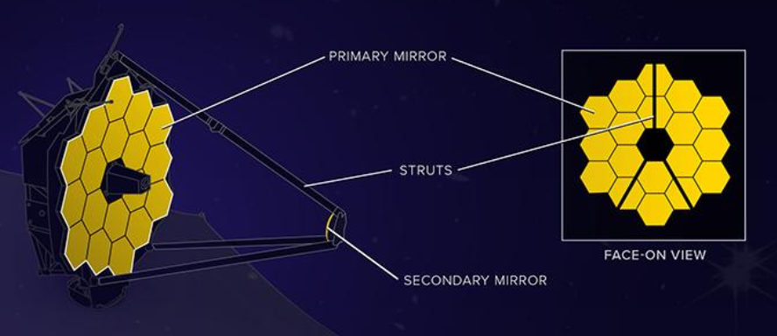
APP PHYSICS 157
FOURIER TRANSFORM MODEL OF IMAGE FORMATION
Strut influence. Just like how the edges of an aperture contribute to the appearance of an image point source or a star, the struts attached to the main mirror assembly also diffracts the light shined through it. The number and position of struts supporting the secondary mirror determine the diffraction patterns it produces.
Since the diffracted light always bends into a single, perpendicular pattern, the resulting strut contributions always converge at the center. These explains why the diffraction pattern for mirrors with strut is different than the the mirror itself, as shown in Figure 12.
In the James Webb, the struts are assembled in a way their diffraction patterns overlap with those created by the primary mirror!
Figure 13. The James Webb space telescope assembly. Image cropped is courtesy of Webb’s Diffraction Spikes (webbtelescope.org).
Hubble
James Webb
Figure 14. Diffraction pattern of the star accounting for the primary mirror and struts contributions, close to the actual images captured by the telescopes. The James Webb space telescope is known for its complex eight-pointed star pattern as shown.

Slide 17
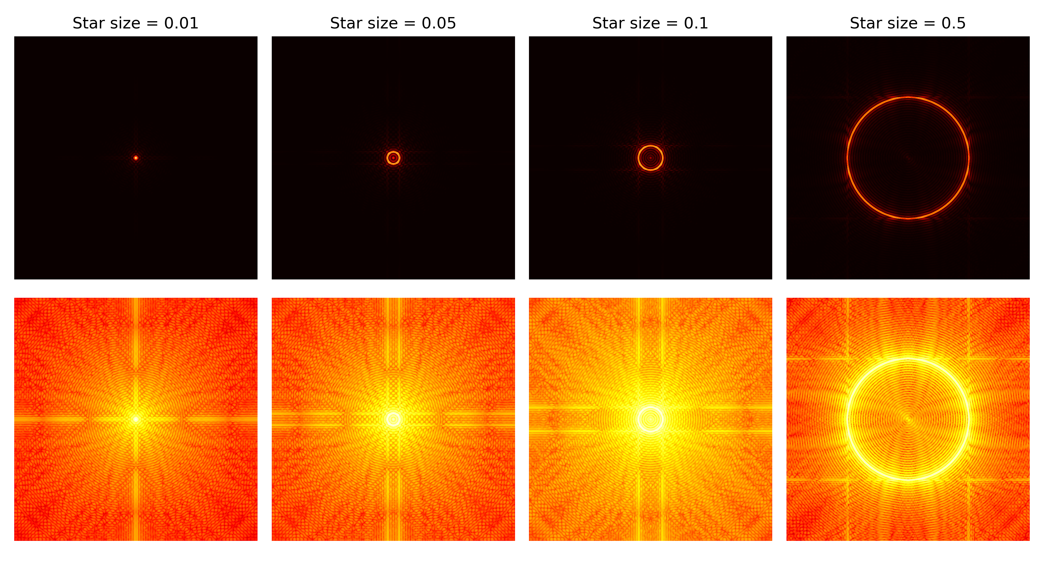

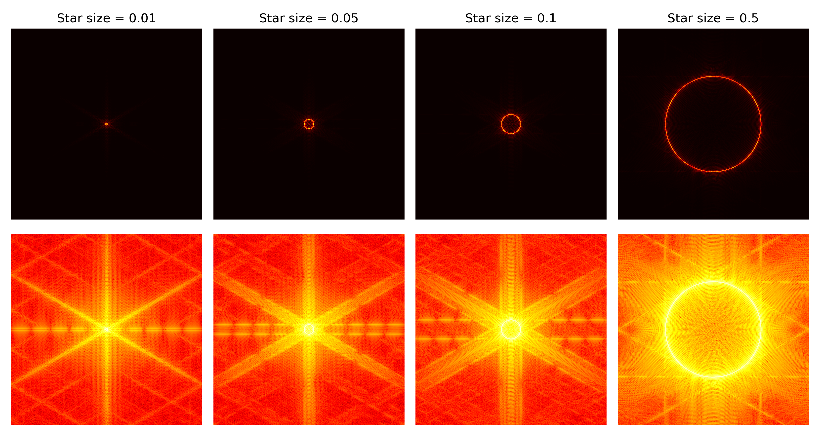
APP PHYSICS 157
FOURIER TRANSFORM MODEL OF IMAGE FORMATION
Hubble
Hubble
James Webb
James Webb
Figure 15. Comparison between the image of a star captured by the Hubble and James Webb space telescopes.
Figure 16. Stars of varying radii when convolved with the Hubble and James Webb space telescopes.

Slide 18
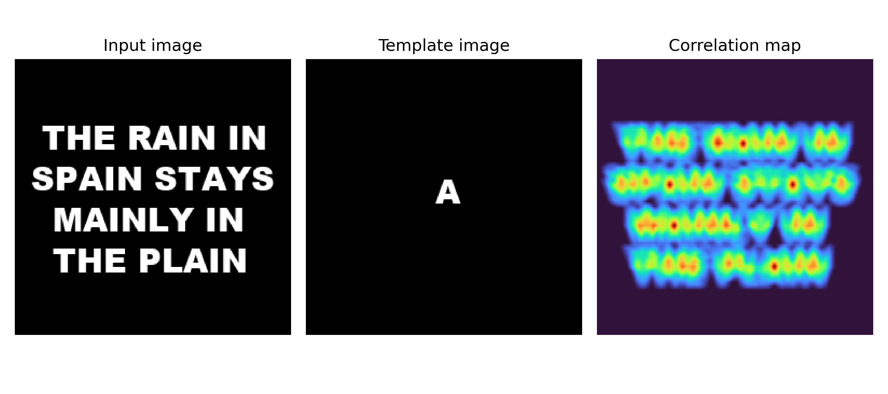
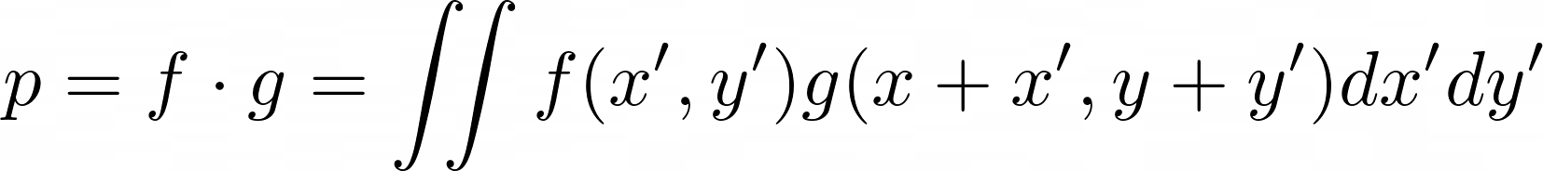
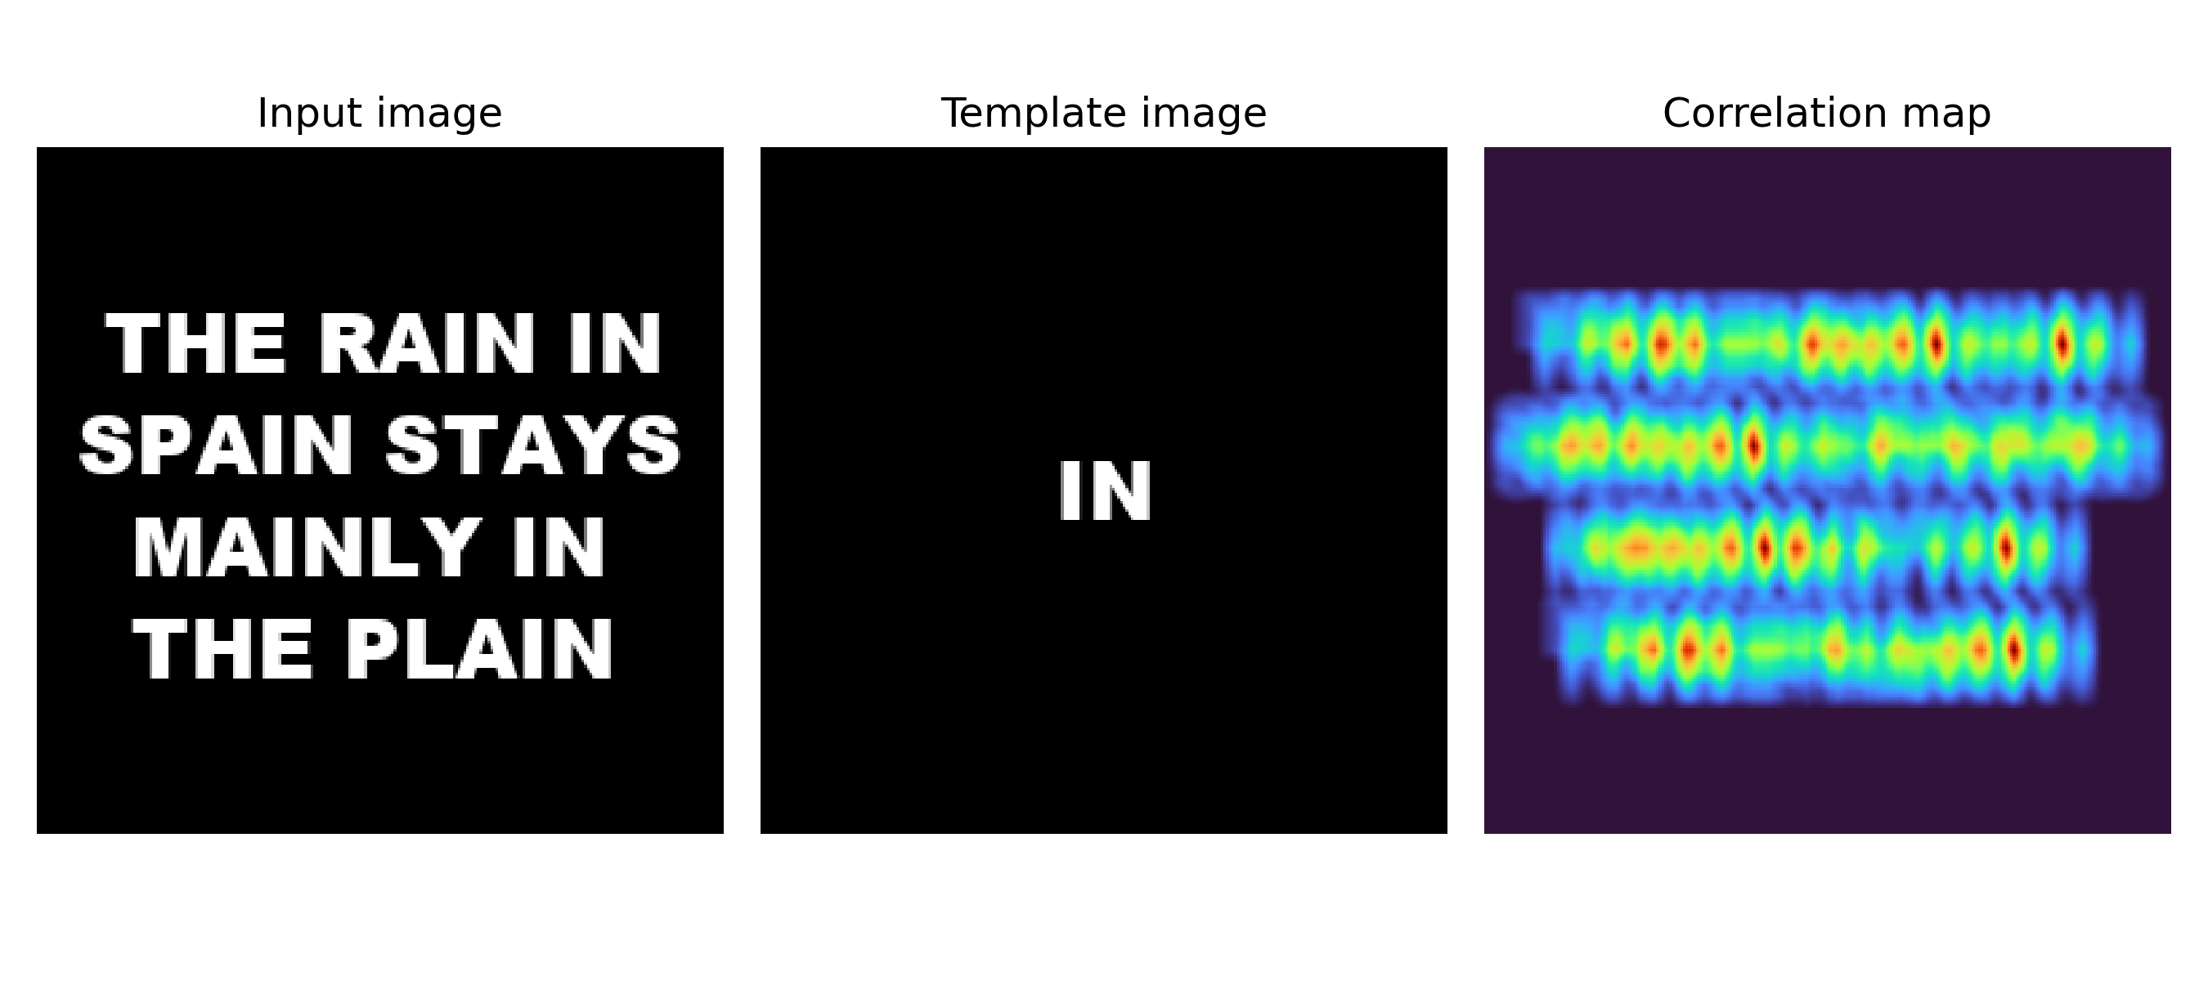
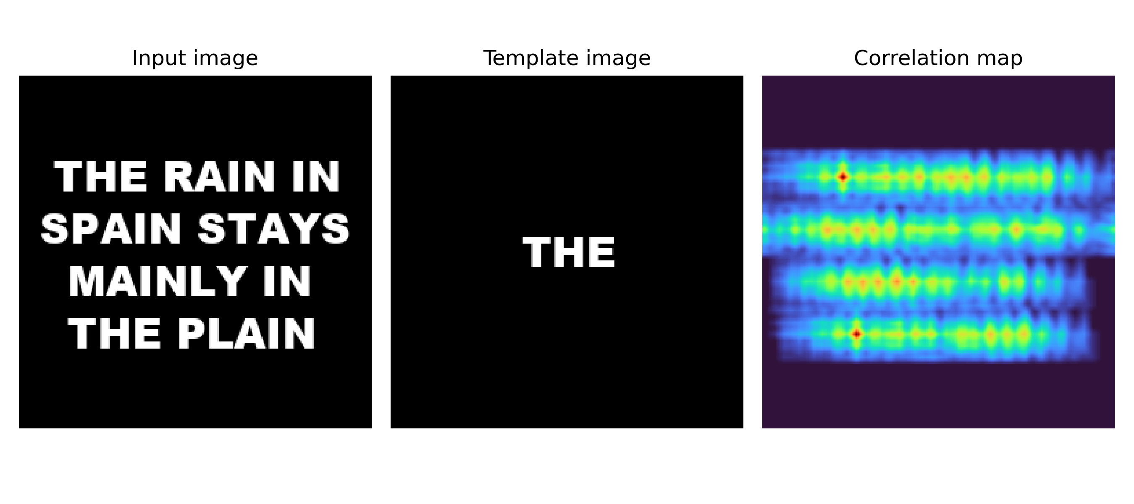
APP PHYSICS 157
FOURIER TRANSFORM MODEL OF IMAGE FORMATION
IMAGE CORRELATION
The correlation between two-dimensional function is given by the equation
by which it can be interpreted as a degree of similarity between two functions, i.e. the more identical they are at a certain position in the image, the higher the correlation value would then be. Image correlation is commonly used as an algorithm in template matching or pattern recognition in certain scenarios.
As shown on the figure, a phrase was made, and certain letters and certain phrases were used as template to determine how the pixels in template image matches certain parts of the phrase image. The red peaks in the correlation map indicates the presence of such text or phrase in the original image!
Figure 17. Image correlation using template matching.

Slide 19
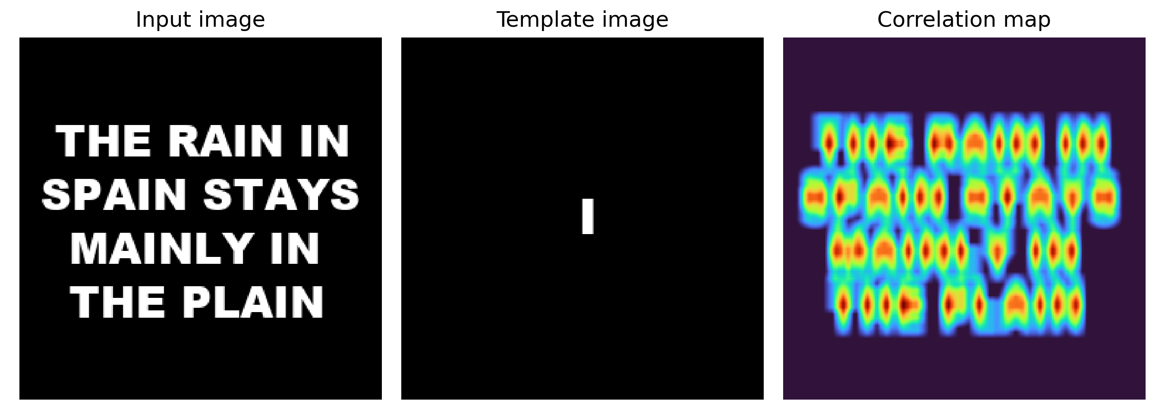
APP PHYSICS 157
FOURIER TRANSFORM MODEL OF IMAGE FORMATION
IMAGE CORRELATION
Some limitations due to the template image used
The algorithm used in image correlation has also some of its limitations. Since it matches the template image and phrase image pixel by pixel, some letter pixel is almost identical to other letters, which somehow limits its ability to template match both images and might yield a high correlation value even though the desired object is not the same as the template. A good concrete example would be shown below for reference.
Figure 18. Image correlation using template matching for letter I.
Compared to the letter A used in Figure 17, the correlation map projected several peaks everywhere even though the template image is only in certain parts of the input. This is because “I” or the vertical line it represents were common in almost all of the letters that make up the phrase image. Hence, all strokes of the letter similar to “I” is returned as high correlation, equivalent to the red peaks.

Slide 20
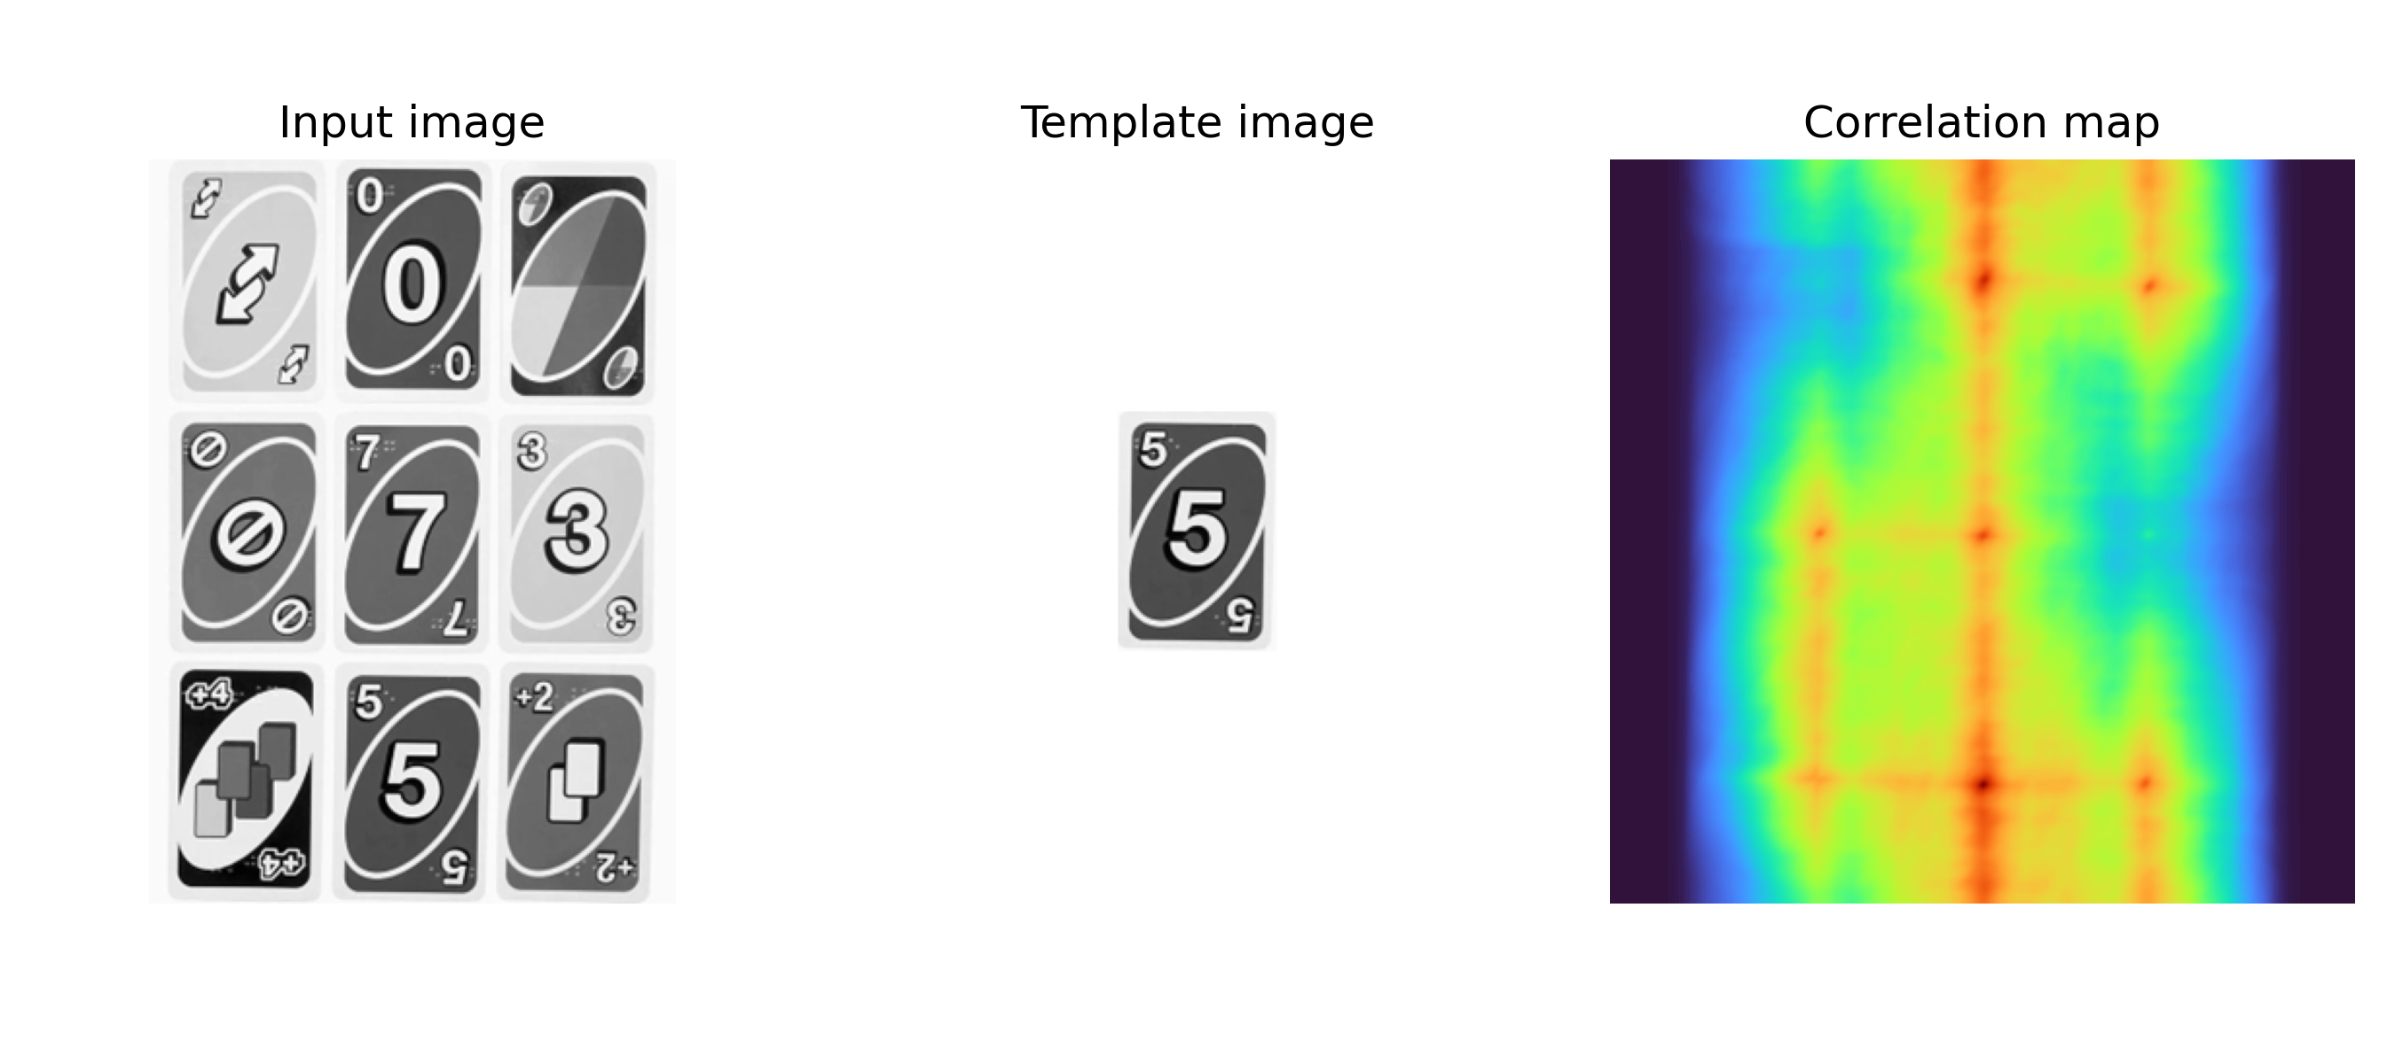
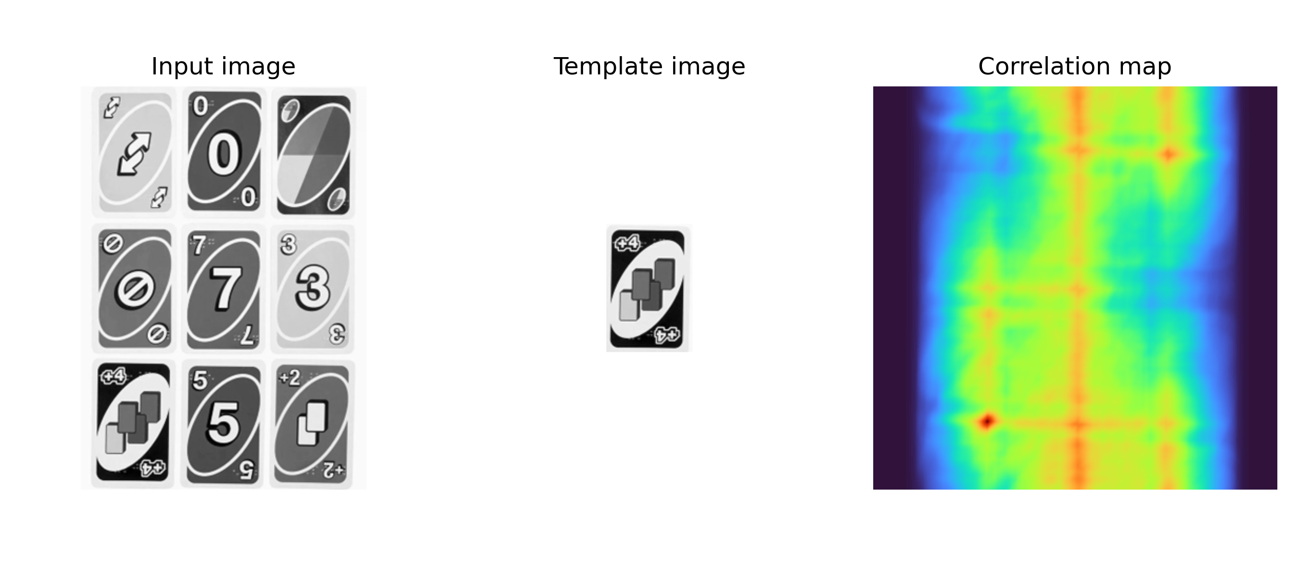
APP PHYSICS 157
FOURIER TRANSFORM MODEL OF IMAGE FORMATION
IMAGE CORRELATION
Figure 19. Image correlation using template matching for UNO cards.
As expected, the dark red peaks appeared on the area where the template image matches the input image pixel by pixel. Yay!

Slide 21
APP PHYSICS 157
FOURIER TRANSFORM MODEL OF IMAGE FORMATION
REFLECTION
Similar to the previous activity, working on images set in a 2^{N} resolution is favored by the FFT algorithm as complex calculations are reduced to a reasonable and comparable factor! Overall, I think I was able to execute the rudimentary of FFT in digital image processing and even meet what is expected beyond the objectives. I was able to address some gaps and nuances in my results as well as the underlying concepts and implications of the resulting images.
I find the activity generally fun since it covers some of the real-world applications of Fourier Transform, which I really look forward to since it transcends beyond the what was taught in the lectures. I was also able to compare the differences of my results to what the theory suggests. Nothing really beats the satisfaction of having your results being close to the theory.
Simulating the imaging systems such as that of space telescopes really struck me as I did not know that FFT goes as far as to how stars are captured by the telescopes. Further study into the mathematics that describes the intensity pattern that arises from different aperture geometry would be interesting as well! Overall, I would give myself a score of 110/100.

Slide 22
APP PHYSICS 157
FOURIER TRANSFORM MODEL OF IMAGE FORMATION
ACKNOWLEDGEMENT
I would like to acknowledge the time and knowledge Sir Rene and Sir Kenneth have shared to us during our laboratory activities and the numerous discussions on the applications of FFT. I also would not have done this without the help of Edneil Soriano upon resolving some of the mistakes I made in my result interpretations and working codes.
REFERENCES | GITHUB
M. Soriano, Applied Physics 157 – Fourier Transform Model of Image Formations, 2023.
FFT (Fast Fourier Transform) Waveform Analysis (dataq.com)
Lesson7.ppt (niu.edu) and OpticsI-20-Diffraction-I.ppt (washington.edu)
FFT - Is there any practical application for performing a double Fourier transform? ...or an inverse Fourier transform on a time-domain input? - Signal Processing Stack Exchange
James Webb telescope - Diffraction artifact on the March 16, 2022 JWST aligned test image - Space Exploration Stack Exchange

